Slide 1
Electronic Clearing House Operation (ECHO)-Web
Grantee Training
2023
Federal Transit Administration

Slide 2
Agenda
Background & Overview
  System Integrations
  System Modules
Using the System
  Role Overview
  Logging In
    Selecting the ECHO Web Application
  Navigation Menu Overview
      Payments Tab
      My Tasks
      Account Management
      Help

Slide 3
Background & Overview
  The ECHO-Web application allows FTA Grant Recipients to request payments from their Grant awards. Grantees make payment requests in ECHO-Web throughout the day. Twice a day, FTA’s internal Financial Management System (FMS) batches and collects these requests for processing and submission to the U.S. Treasury.
Notes:
The ECHO-Web application allows FTA Grant Recipients to request payments from their Grant awards. Grantees may make payment requests in ECHO-Web throughout the day. Twice a day, FTA’s internal Financial Management System (FMS) batches and collects these requests for processing and submission to the U.S. Treasury.

Slide 4
ECHO Web System Integrations
System for Award Management (SAM)
FTA’s Transit Award Management System (TrAMS)
Imports organizational information from SAM.gov
FTA’s Internal Financial Management System (FMS)
Imports the status of payment disbursements
Initiates the Payment Request Process
FTA’s Access Control and Entry System (FACES)
User Management
Login.gov
Authentication upon login
Notes:
ECHO-Web is integrated with several other systems, working together to deliver the grant payment request functionality.
Security is crucial for FTA Applications. Users are authenticated into ECHO-WEb via Login.gov. We will cover more information on how that works later in the presentation.
In addition, FTA utilizes the FTA Access Control and Entry System (FACES) for managing user roles in ECHO-Web. This system will allow users to manage permissions to the system as well as run user reports.
SAM.gov is the government’s main source of information for grant recipient organization information. ECHO-Web interfaces with SAM.gov to pull this information, so it is very important to ensure that your organization’s SAM.gov profile is accurate.
Once a user is securely logged in and has received the “Grantee” role associated with an Organization, they are able to request payments. Once submitted through ECHO Web, the payment request goes through FTA’s Internal Financial Management System (FMS) as a final check before submission to the US Treasury.
After a decision from the Treasury has been made, TrAMS provides ECHO Web with the payment disbursement status. TrAMS also provides grant-related information to ECHO-Web, including information like the grant number and various grant-related codes.
https://sam.gov/content/home
https://www.login.gov/help/get-started/create-your-account/

Slide 5
Prerequisites for Using the System
Prerequisites for Login
Active ECHO Web Role
Association with an Organization
Active FTA FACES User Account
Active Login.gov account
Notes:
In order to use the System, the following prerequisites must be met:
The user must have a FACES User Account with an ECHO Web Role
Users must be associated with an Organization
Users must have an active Login.gov account

Slide 6
System Modules
Payment Management
Account Management
Task Management
Help Management
Submit Payment Requests
Modify/Cancel
View the submission status
View the payment status
Allows users to pickup where they left off
Saves progress
View Organizations SAM status
View recipients and users
Policy or System Related Documents that should be shared.
Easily modifiable FAQs and Help Section
Notes:
The capabilities of the ECHO-Web system fall into 4 major areas. Let’s look at these in a little bit of detail. These 4 modules include the management of the following:
Payments – functionality that allows users to submit payment requests, modify or cancel payment requests before transmission to FMS, view the status of their submitted requests, and view the final status of payment.
Task Management – functionality that allows users to resume a grant payment request where they left off, if they have to break the connection before they complete a submission.
Account Management – functionality that allows users to view their organization’s SAM status, basic information, and the list of users associated with that organization
Help Management – functionality that allows FTA to share documents, policies, FAQs, and other information with the user community

Slide 7
Role Overview
Read Only
User Manager
Authorizing Official
Manages Users
Recertification
Organizational Level View
Receives notification of payment requests from their organization
Can view data within an associated organization
Grantee
Create/Modify/Cancel Payment Requests
Notes:
ECHO-Web has four main system roles for grant recipient users:
User Manager: This is a user within the organization who can manage the roles of other users, deactivate or reactivate users, and lock or unlock accounts
Authorizing Official: This is a required role that every organization must have filled in order to request payments. The AO receives notifications whenever any payment request is submitted for an organization
Read Only: Users with this role can only view payment requests and the basic information about their organization, and cannot take any other actions to submit payment requests. User Managers can have a Read-Only role in addition to being a User Manager, but no other roles in ECHO-Web are compatible with the Read-Only role
Grantee: Users with the Grantee role may create and submit payment requests for their organization in ECHO-Web

Slide 8
ECHO Web Demonstration

Slide 9
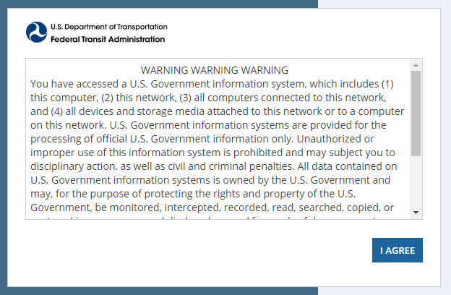
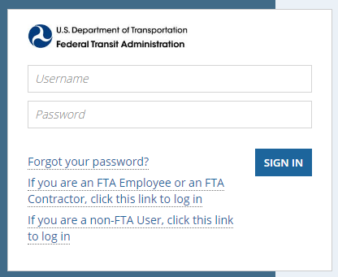
Logging In
ECHO Login URL: https://faces.fta.dot.gov/suite/
Login.gov: https://www.login.gov/help/get-started/create-your-account/
Notes:
To login, navigate to https://faces.fta.dot.gov/suite/ & Agree to the security policy
Once you agree to the security policy, you will be taken to another screen where you have 3 options.
If you forget your password, do not click “Forgot your password?” Instead, go to Login.gov and reset your password there.
Otherwise, click the second option stating “If you are a non- FTA User, click this link to log in”
Once clicked, your information is automatically authenticated using your Login.gov account. If you do not have a Login.gov account, please navigate to https://www.login.gov/help/get-started/create-your-account/ to create your account.

Slide 10
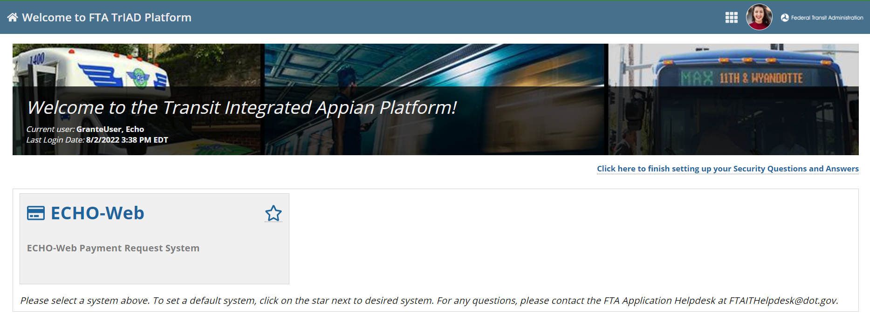
Logging In
Notes:
Once logged in, you will be taken to the Transit Integrated Appian Platform, or “TrIAD,” Home Page. This is a landing page for many FTA applications, and some of you may already be familiar with this page from using other FTA systems.
An option for ECHO Web will be selectable from the screen. If you have access to additional applications, they will be shown here as well.
Please select ECHO Web to be taken to the application

Slide 11
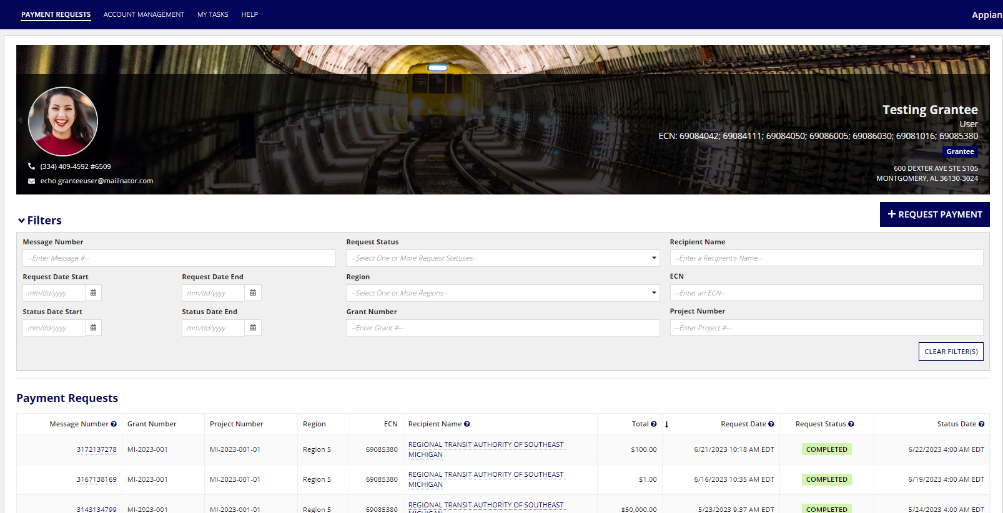
Landing Page | Payments Tab
Main Navigation Menu
Collapsible Filter
Payment Grid
Notes:
Upon selection, you will automatically be taken to the ECHO Web Landing Page.
The Landing Page automatically shows the logged-in User’s Information as well as the Payment Requests associated with that User’s organization.
The image above reflects a user with a Grantee Role who has access to a single organization.
The Main Navigation bar can be seen at the top of the page outlined in Orange. Here we have
Payment Requests
My Tasks
Account Management
Help
The Collapsible Filters section allow users to search the payments by several fields including
Message Number
Dates
Process Status
Region
TrAMS Grant Number
Recipient Name
ECN
Project Number
The Payment Requests Grid shows high level information regarding the payment and is selectable by Message Number.
The Message Number: Unique Identifier of the Payment
Grant: The Grant the Payment is associated with
Project: Project Number
Region: Associated Region
ECN: Echo Control Number
Recipient: The Grantee or Organization
Total: Total sum of the Project Lines within the Request
Request Date: Date the Request was made
Status: Overall Process Status of the Payment
Status Date: The Last time and date the Process Status was modified

Slide 12
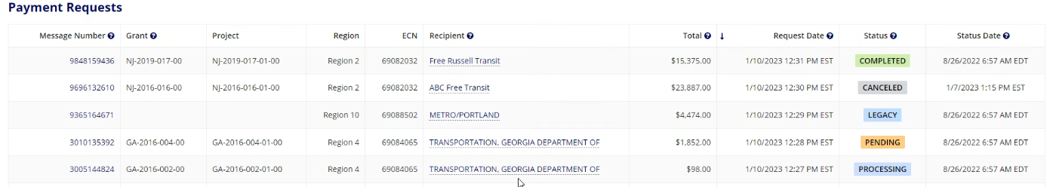
Landing Page | Payments Tab
Notes:
There are 5 different Statuses that can be attributed to a Payment Request:
Completed: The payment request is completed and has been accepted in FMS.
Canceled: The user canceled the payment request before it could be transmitted to FMS.
Legacy: This payment request is a legacy record from the prior ECHO-Web system.
Pending: This payment request has not yet been transmitted to FMS.
Processing: This payment request has been sent to FMS, but FMS has not yet accepted or rejected the payment request.
Please note: there may be situations where ECHO records a “completed” payment request that FMS subsequently rejects. This is because this status only indicates that the payment has finished processing in FMS. FTA recognizes that this language can be confusing, and we are working on better integration between these systems.

Slide 13
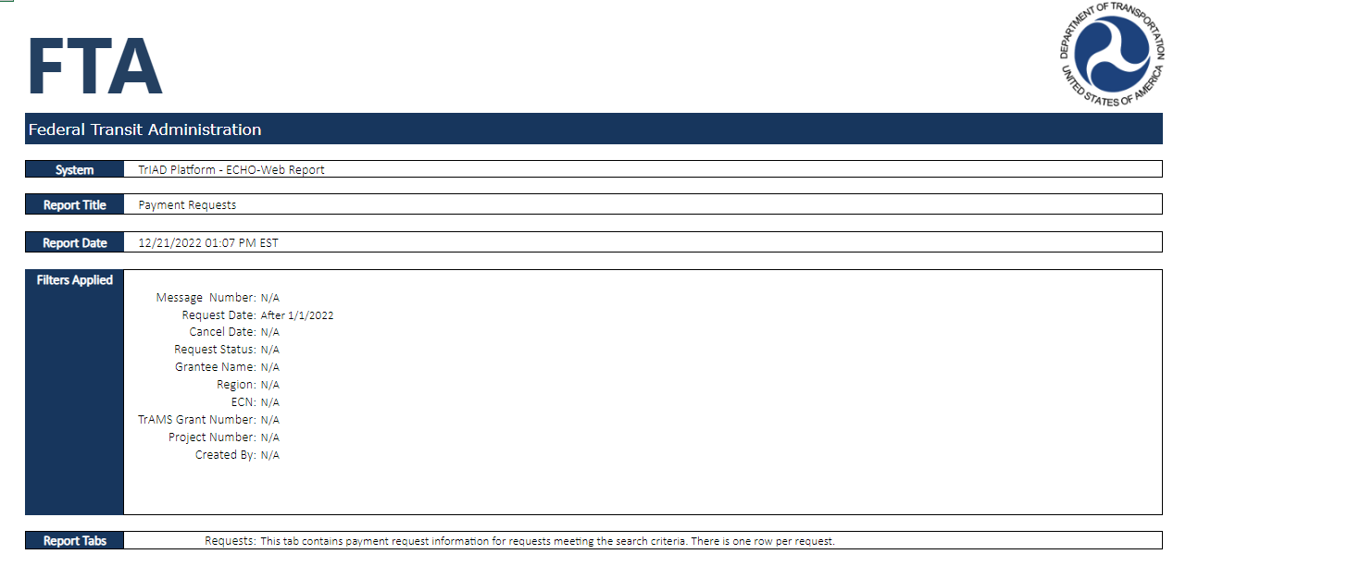
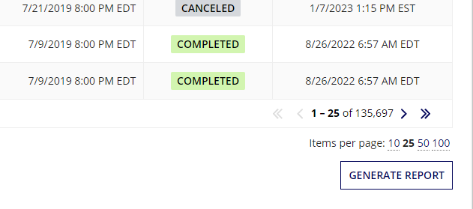
Payment Report
Notes:
By scrolling to the bottom of the grid, an excel export is available by selecting the GENERATE REPORT Button
An example of the report can be found by clicking the excel link within the slide
The report itself contains the following columns:
Request Status
Request Date
Request Number
TrAMS Grant Number
Project Number
Purchase Order Number
Scope Suffix
Po Balance
Request Amount
Return Amount
Total Request Amount
Message Number
Cancel Date
ECN

Slide 14
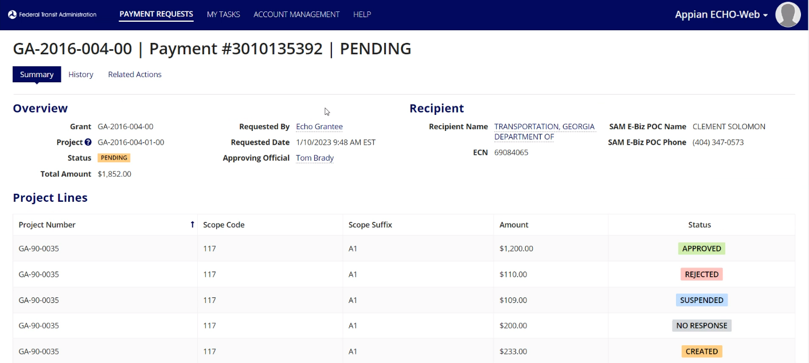
Payment Record
Notes:
The payment record shows the a detailed submission status of a payment request.
The overview section shows the Grant Number, Project Number, status of the request, and total amount of the request. The Recipient information is imported from SAM.gov. The Recipient name is clickable and will take you to the Recipient Record.
The Project Lines section shows the individual line item payment requests.
Each of the Project line items can have a different status based on the decision of the treasury. For the purpose of Training, we have them all listed here.
Created: Before a decision has been made from the Treasury, the line item remains in the Created status.
Suspended: This status occurs when the payment request failed a validation in one of the other FTA or Treasury systems. This can happen if TrAMS doesn't have a matching funding source, if the grant doesn't have enough funds available, or if a technical problem occurs in FMS.
No Response: If there is a System Error or the SAM expiration date has passed, the status will reflect No Response and the system will give instructions to contact the Help Desk.
Approved: Funding has been distributed
Rejected: Treasury rejected the request
Message number used for demonstration: 3010135392

