Slide 1
Cost to Cure
A limited appraisal technique to reduce damage payments

Slide 2
The concept of damages
Vacant residential lot
Zoning requires a minimum lot size of 9000 SF
If lot reduced below minimum, no building permit will be issued

Slide 3
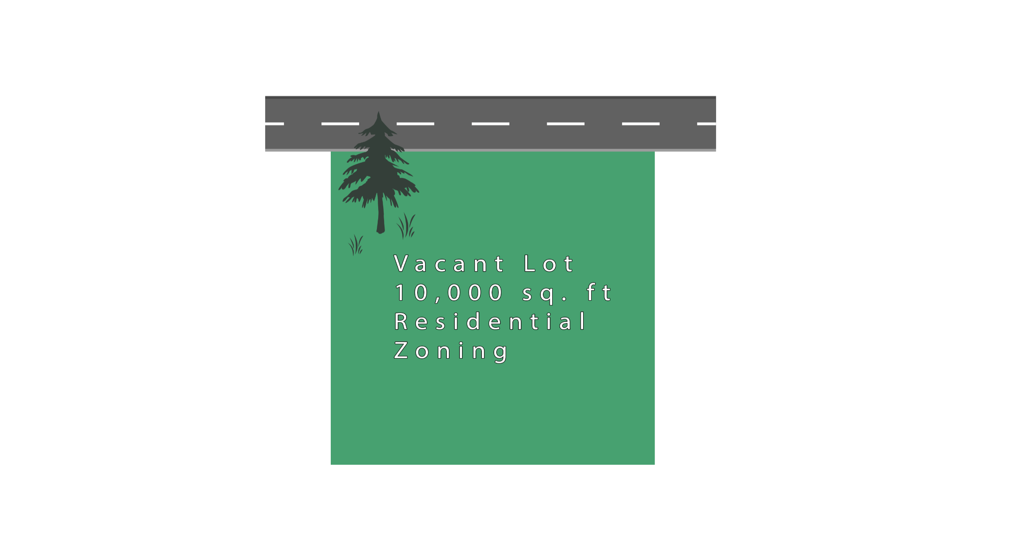
Before situation

Slide 4
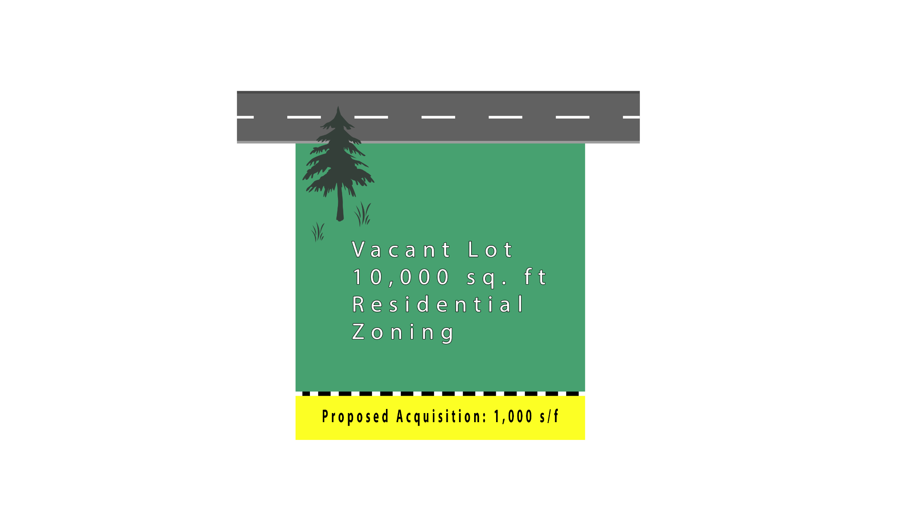
Showing taking in situation 1

Slide 5
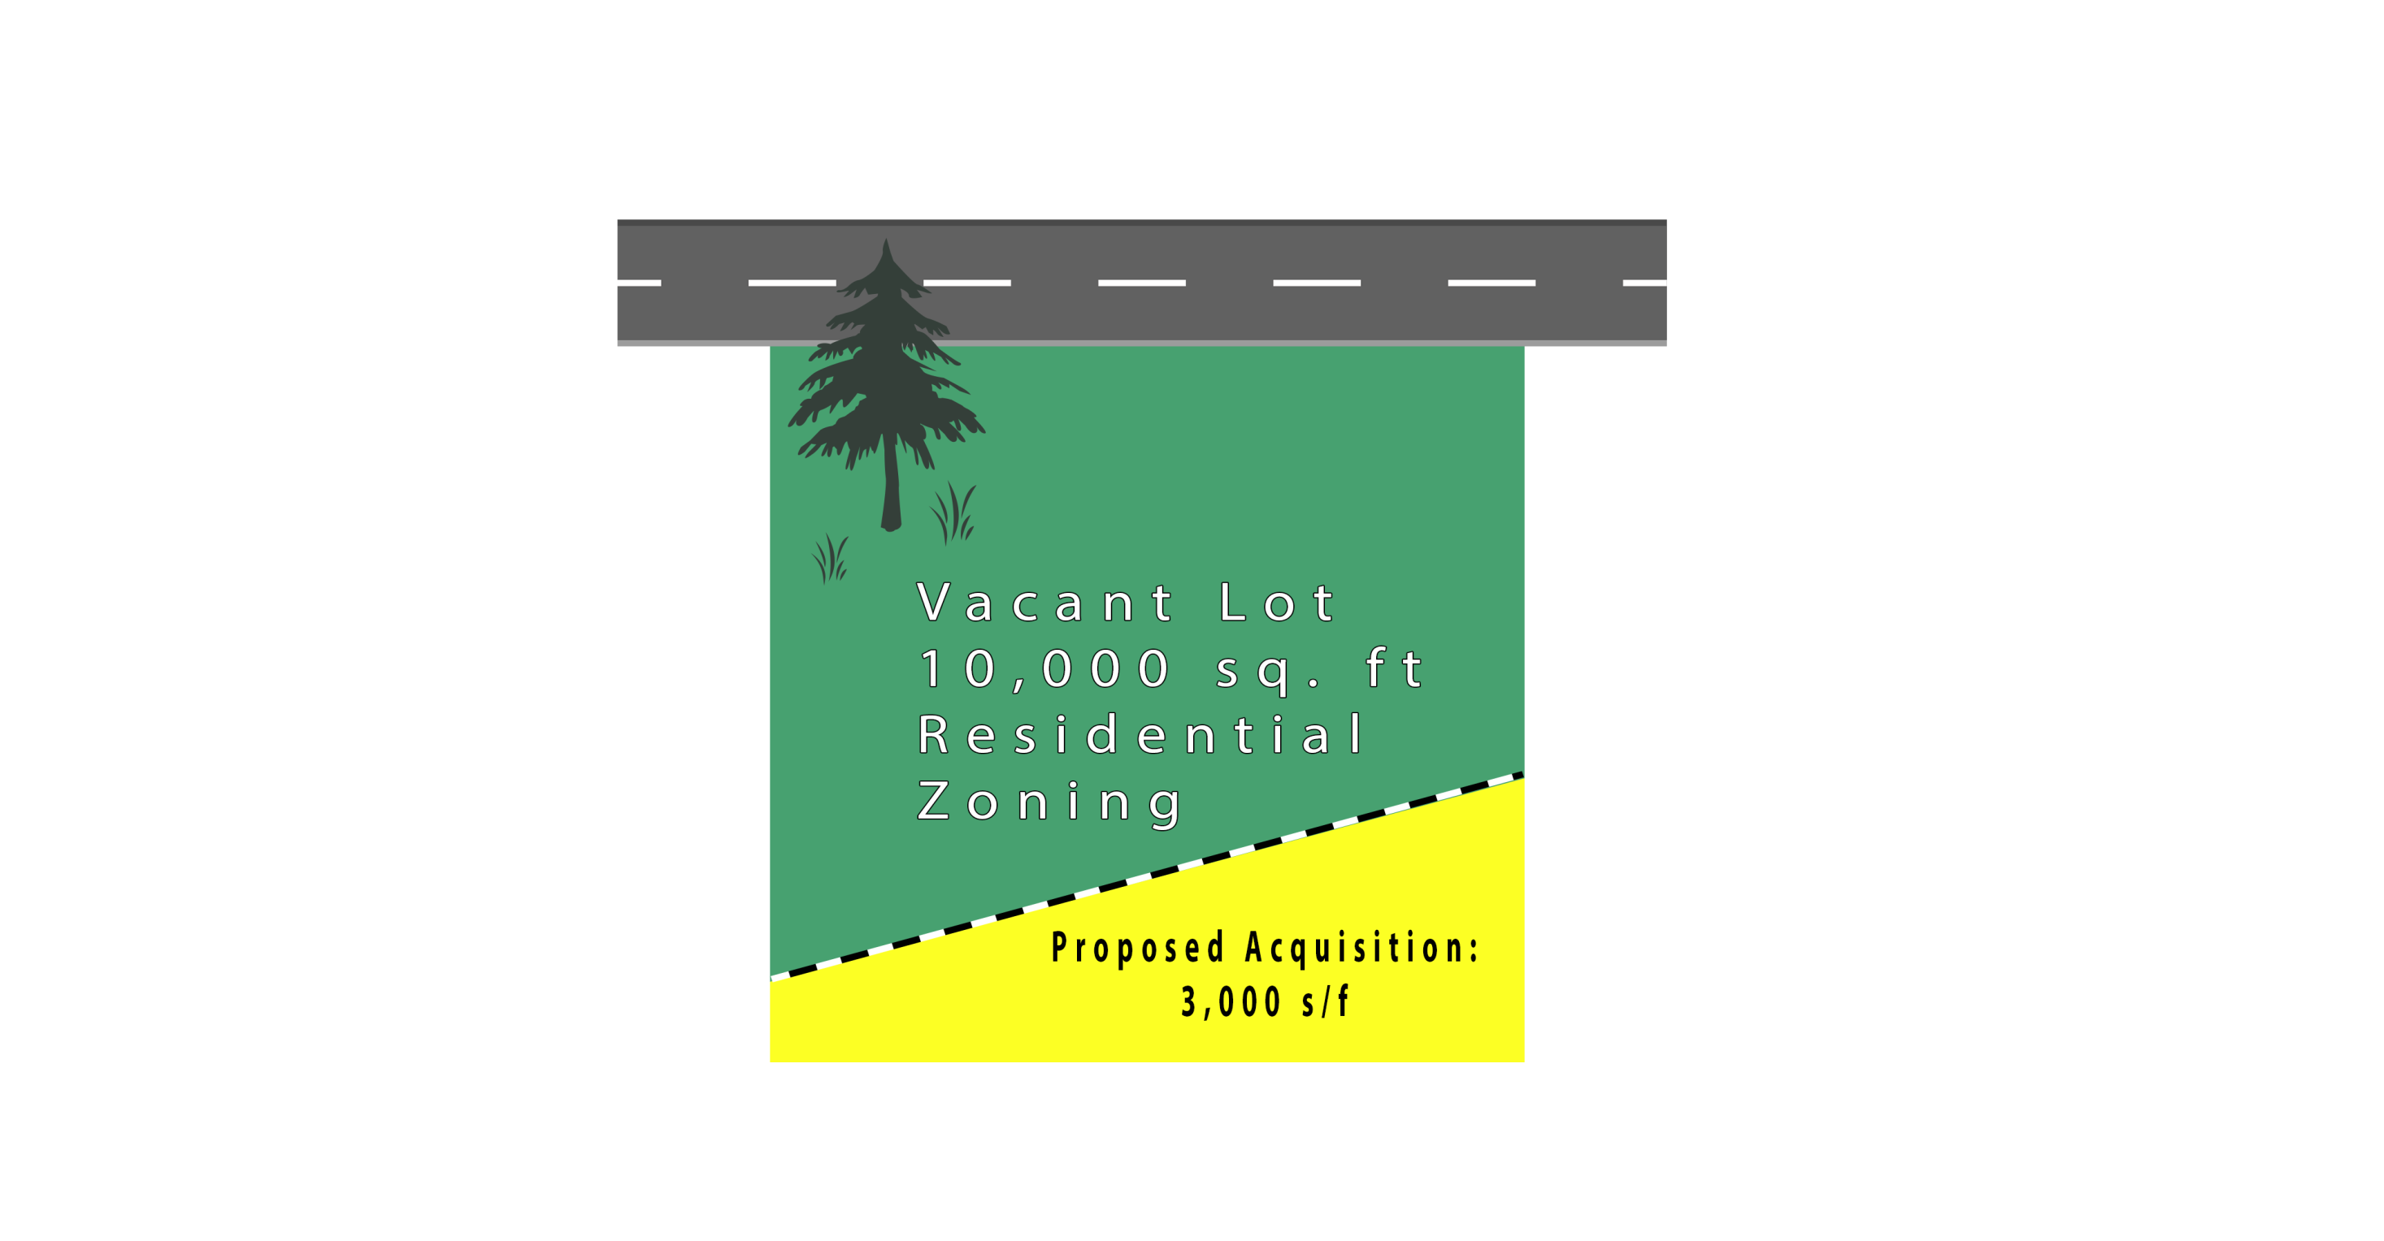
Showing taking in situation 2

Slide 6
Illustration of cost to cure
Retail stores with dumpster screening enclosure
If enclosure is taken, it must be replaced or the property cannot be used as retail
Cure may consider construction of new enclosure
Cure may necessitate changes to parking lot space layout.

Slide 7
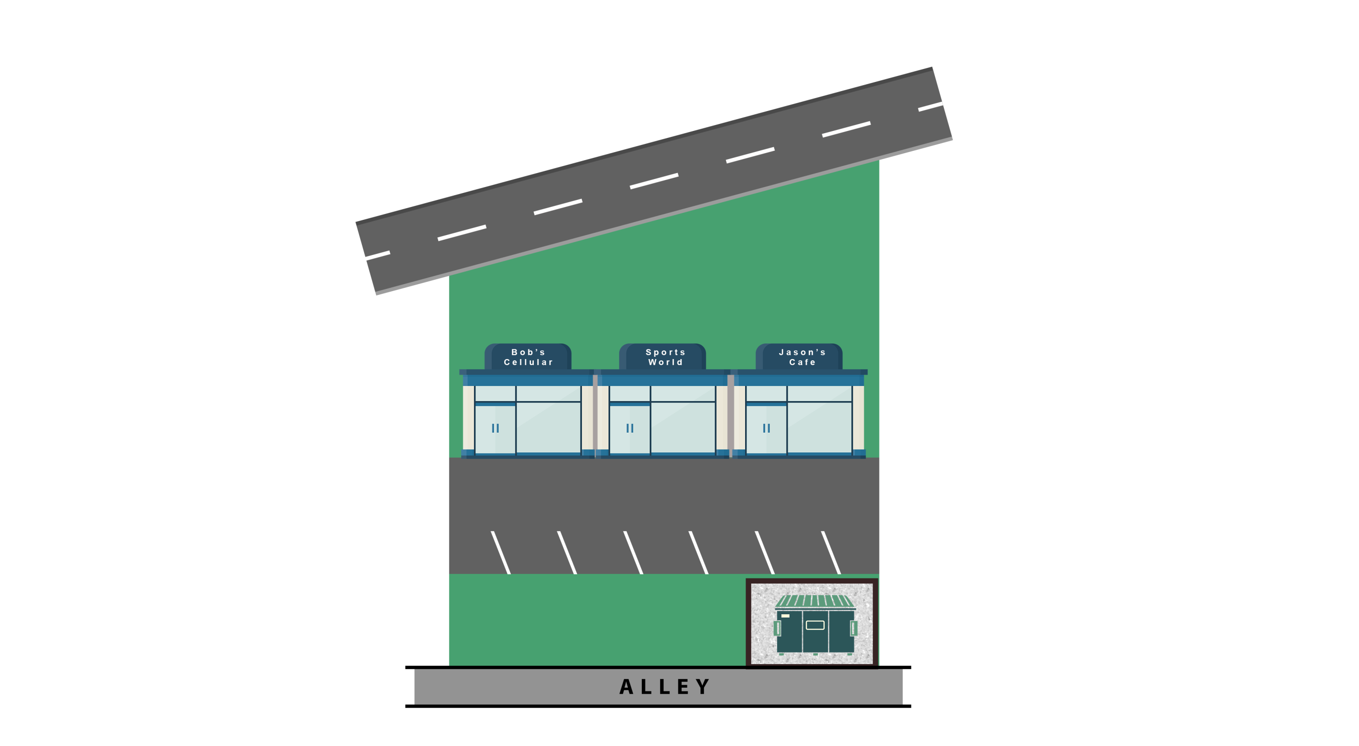
Before situation

Slide 8
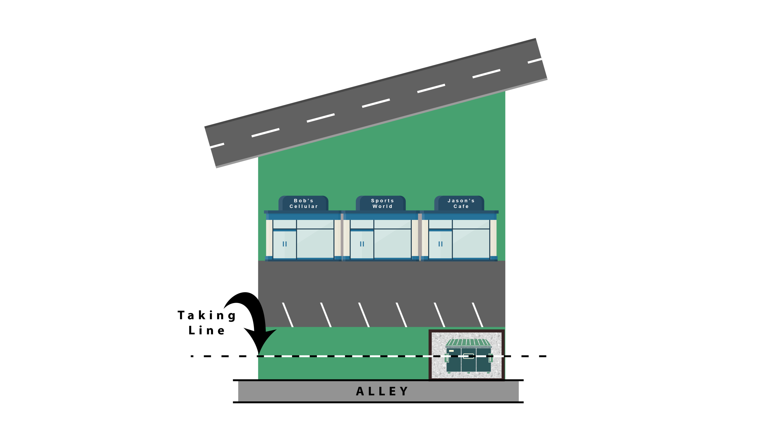
Showing taking

Slide 9
Cut and Re-face in cost to cure
Small take from rear of grocery store
Assumption is current use is highest and best use; and that “cure” offsets more damages than it cost of the cure.

Slide 10
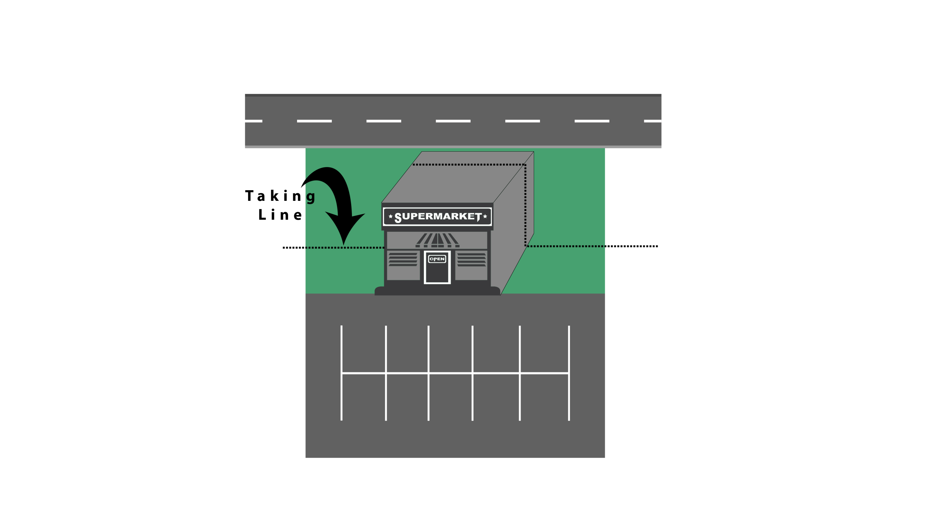
Title here

Slide 11
Basic Rules
Cost to cure should be addressed in appraisal Scope of Work
Cure must be physically and economically prudent
Adjacent land cannot be considered in cure*
Cost to cure cannot exceed the diminution of value that would occur without the cure
* State law varies

