Slide 1
National Transit Database
NTD 2.0 Reporting for States
Report Year 2015

Slide 2
Contact Information
National Transit Database
943 Glenwood Station Lane, Suite 102
Charlottesville, VA 22901
Help Desk
(888) 252-0936
NTDHelp@dot.gov
Monday- Friday
0800 – 1900 Eastern

Slide 3
Presenter
Joseph Eldredge
Joseph.eldredge.ctr@dot.gov
434-993-8690

Slide 4
Agenda
Report Year 2015 Changes and Clarifications
NTD 2.0 System Overview
User Manager Rights and Privileges
Report Year Kickoff
Annual Form Navigation
Submission
Validation Process

Slide 5
Report Year 2015 Changes and Clarifications

Slide 6
Policy Clarification: Data Reporting
Purchased Transportation Services
Transit agencies must report all services they operate, and in most cases, the services that they purchase. Therefore, sellers of PT service typically do not report to the NTD.
This is a policy clarification as there were instances of sellers reporting to the NTD in 2014.

Slide 7
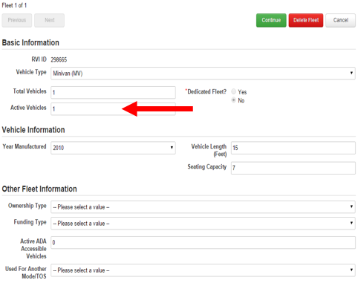
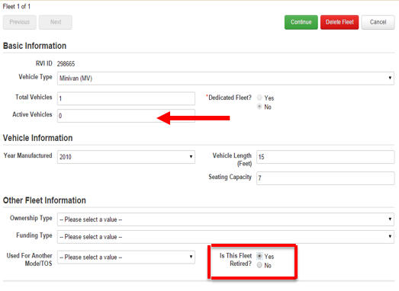
Reporting Clarification: Deleting Fleets
When a fleet is no longer in use, do NOT click “Delete Fleet”
Instead, change “Active Vehicles” to 0 then
“Is This Fleet Retired?” field will be prompted
Select “Yes” and click “Continue” and save the form

Slide 8
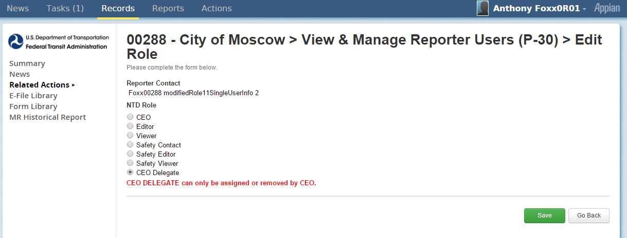
New Role: CEO Delegate
P-30:
NTD 2.0 requires at least two contacts,
One contact must be the head of the transit unit (CEO)
A CEO Delegate would be assigned by the CEO if the CEO does not work on, or submit the NTD report. Completing the process would delegate the NTD report to another user.

Slide 9
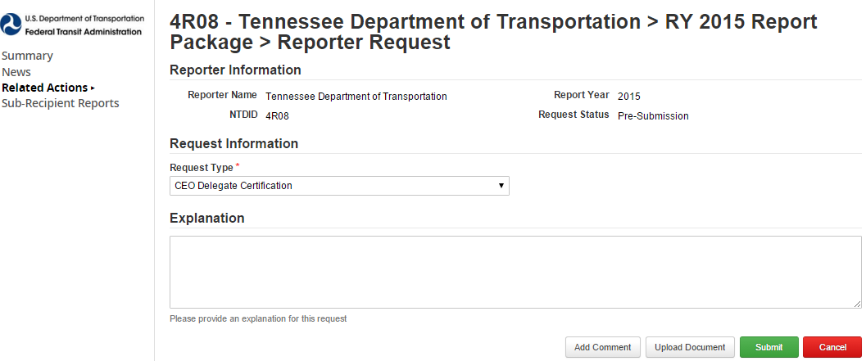
CEO Delegate Certification
Before updating the User Role on the P-30, the CEO must complete and upload a CEO Delegate Certification, through the State DOT Report Package > Reporter Requests

Slide 10
Review: RR-20 Cost Allocation Methods
Determine which expenses are direct expenses and can be easily attributed to a particular mode/TOS.
Determine which expenses are shared expenses. These costs are incurred for the benefit of more than one mode/ TOS and cannot be easily attributed to a specific mode/TOS.
Allocate shared expenses or shared costs to each mode/TOS using an allocation method:
Revenue Hours
Revenue Miles
Number of Employees
Ridership

Slide 11
Cost Allocation Example
Subrecipient operates a Demand Response (DR) service and a fixed-route bus (MB) service
Collects Annual Vehicle Revenue Miles (VRM) for each mode separately.
Total Annual Operating Expenses: $100,000
DR: 200,000 VRM
MB: 300,000 VRM
$$\frac{200,000 DR miles}{500,000 total miles}=\frac{DR operating cost}{\$100,000 joint operating cost}$$
$$\frac{200,000 }{500,000 }×\$100,000=DR operating cost$$
$$\$40,000=DR operating cost$$
$$\$60,000=MB operating cost$$

Slide 12
Review: Accounting Requirements
Generally Accepted Accounting Principles (GAAP)
If conflict exists, use NTD requirements
Accrual accounting
Revenue recorded when earned, regardless of when payment is received
Expenses recorded when liability occurs, regardless of when payment is made
Notes:
Accounting requirements – NTD reporting requirements for financial data follow generally accepted accounting principles (GAAP) and accrual accounting.
The NTD program is a system of accounts that complies with GAAP and Standards of Governmental Accounting and Financial Reporting. However, small differences exist between NTD and GAAP, relating to the accounting of costs for capital grant purchases. If there are conflicts between GAAP and NTD reporting instructions and requirements, NTD rules are to be followed.
Accrual accounting – Revenue is recorded when earned, regardless of when payment is received. Expenses are recorded when the liability occurs, regardless of when the payment is made.
Source: www.ntdprogram.gov

Slide 13
NTD Key Reference Documents
Uniform System of Accounts (USOA)
Outlines the basic accounting structure all NTD reporters must follow
Policy Manual
Issued annually to provide detailed guidance on how to complete NTD forms
User Manuals
issued annually to provide guidance on using the NTD 2.0 on-line reporting system
Notes:
RY15 Policy Manual has been published to NTD Program website.

Slide 14
NTD 2.0 Overview

Slide 15
Report Year 2015
Reporting Deadlines:
Fiscal Year End Date | January 1 – June 30 | July 1 – September 30 | October 1 – December 31
Report Due Date | November 30 | January 31 | April 30

Slide 16
User Manager
Each agency must submit an official letter designating an employee as the User Manager.
User Managers create accounts for the CEO and NTD Contact as well as accounts for editors and viewers.
The User Manager can also fill a NTD Role - for example, the CEO can also be the agency’s UM.

Slide 17
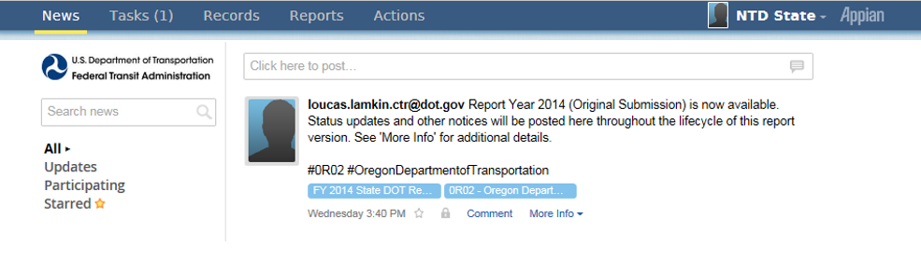
Interface overview
All users land on the News feed
Posts from NTD staff will display here
Note: Analysts do not receive notifications from News Feed items
Eg., Comments on a package submission

Slide 18
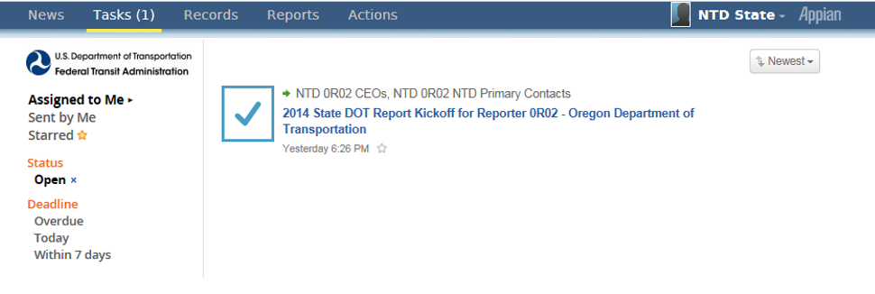
Tasks
Kickoff Tasks are assigned to CEOs and NTD Contacts
Kickoffs populate the packages for all the subrecipients in that Report Year

Slide 19
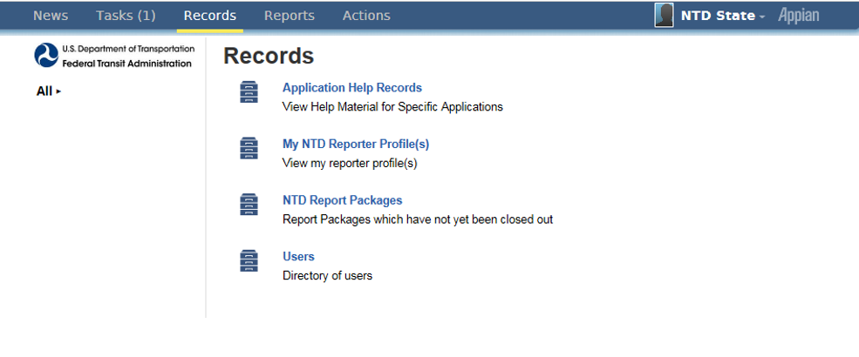
Records
Profiles and Package Forms are accessed through “Records”

Slide 20
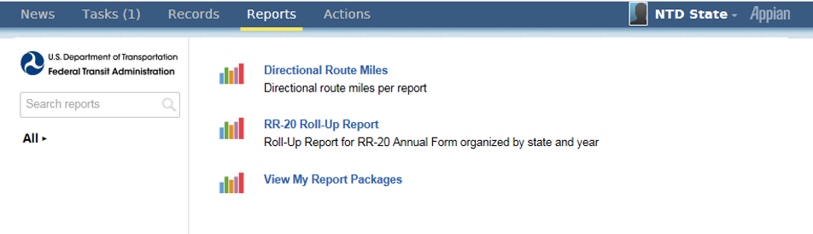
Reports
The RR-20 Roll-Up Report functions like the old system’s RU-30

Slide 21
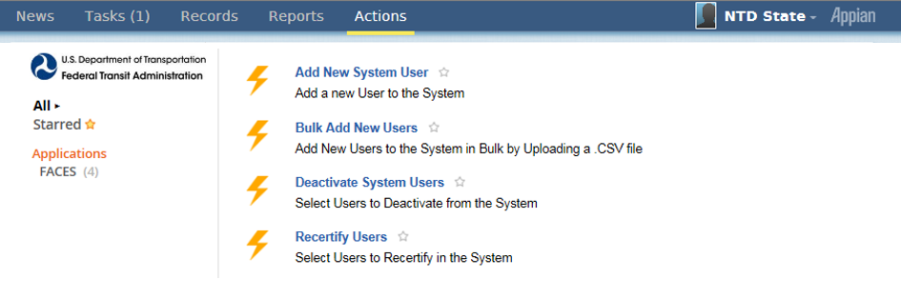
Actions
Options vary based on user privileges
Image below shows Actions tab for a User Manager

Slide 22
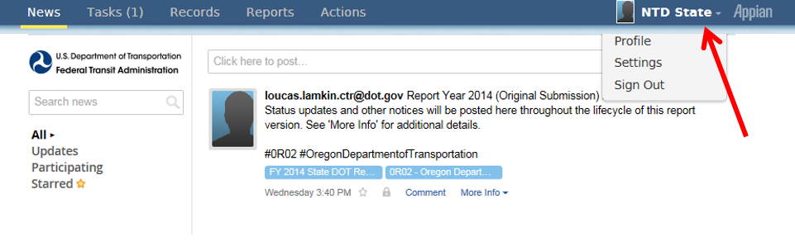
Account Settings
Click your name to update your profile or change account password

Slide 23
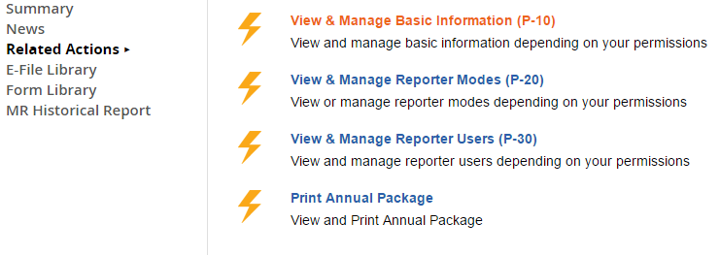
Profile Forms
NTD Reporter Profile Forms
P-10 : Basic Information
P-20: Reporter Modes
P-30: Reporter Users

Slide 24
Report Package Forms
A Report Package contains all of the forms required for annual reporting
Identification (B-10)
Stations & Maintenance Facilities (A-10)
Revenue Vehicle Inventory (A-30)
Reduced Reporting (RR-20)

Slide 25
User Management

Slide 26
Resetting Passwords
Click “Forgot Password” from main login screen
Enter the email address used for your user name and click “Request Password Reset”

Slide 27
Temporary Link for Password Reset
Check email for link to reset password
The link sent to your email expires after 15 minutes after it is sent

Slide 28
Defining Users
Click on Records
Only the User Manager can create new users

Slide 29
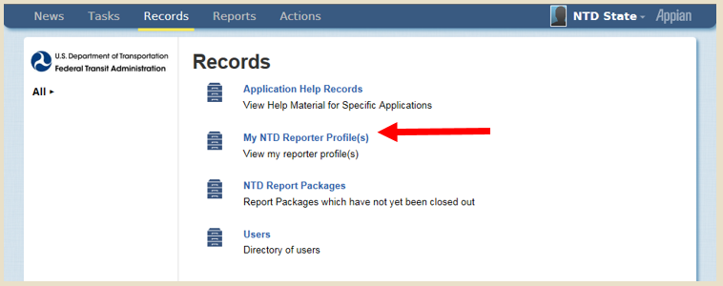
Defining Users
Select “My NTD Reporter Profile(s)”

Slide 30
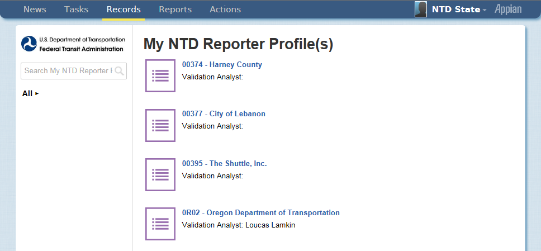
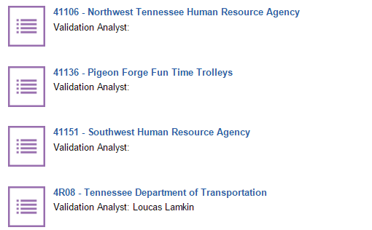
Defining Users
Select your State Profile
State users won’t see Profiles for Urban agencies unless a viewer of the Urban Report.

Slide 31
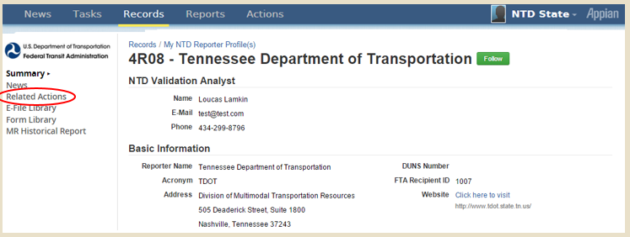
Defining Users
Select Related Actions
All forms have a non-editable “Summary” page
Data Entry & Edits require a “Related Action”

Slide 32
Defining Users
Select the P-30 (Reporter Users)

Slide 33
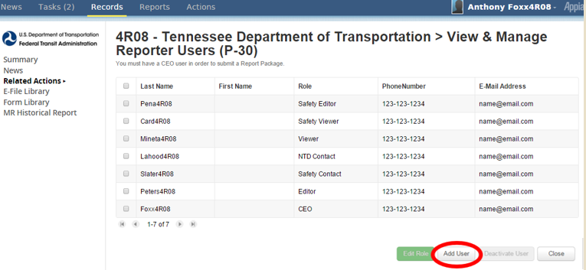
Defining Users
Click “Add User”
Once you click “Add”, you will be able to enter data for that user

Slide 34
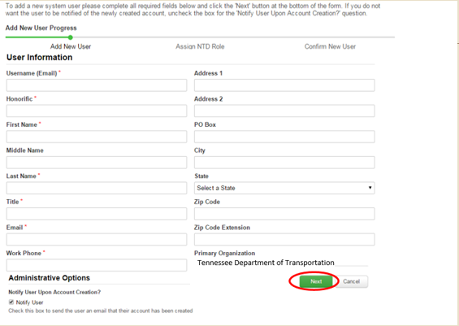
Enter Data
Enter Data
Fields with a red asterisk are required

Slide 35
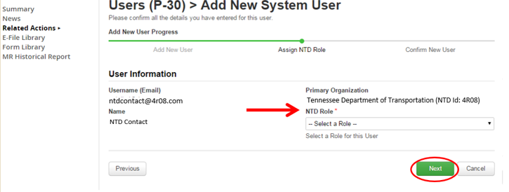
Defining Users
Assign Role
Assign the user’s role
NTD Requires at least two users:
CEO
One additional user

Slide 36
NTD Roles
NTD 2.0
CEO
CEO Delegate
NTD Contact
Editor
Viewer
CEO or CEO Delegate must complete the Original Submission
NTD Contact can submit subsequent revisions

Slide 37
Permissions by Role
CEO & CEO Delegate:
Creating reporter requests (waivers, extension requests, etc.)
Submit annual report package
Can view and edit forms and issues
NTD Contact:
Can submit all annual report after the original submission by the CEO
Can view and edit forms and issues
Editor:
Can view and edit forms and issues
Viewer:
Can view forms and issues

Slide 38
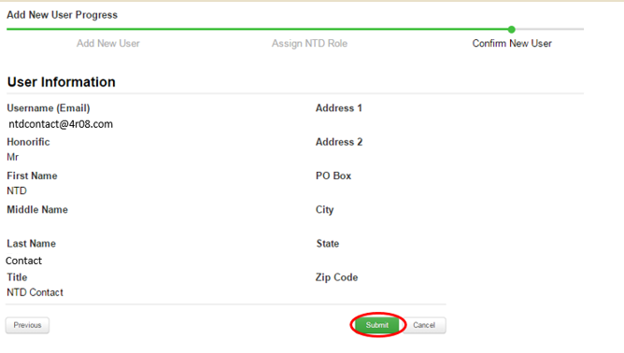
Defining Users
Submit
Finish by pressing submit

Slide 39
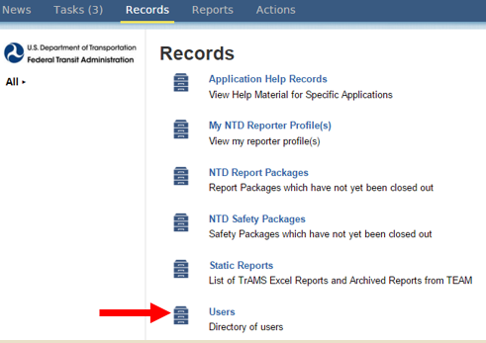
Editing User Information
Only the User Manager (UM) can edit other’s contact information
Click “Users” under the Records tab to complete the search and update.

Slide 40
Editing User Information
If the User is logged on, they may update their own account information under “Profile”

Slide 41
Starting the Report

Slide 42
Report Year Kickoff
Click on Tasks and select the Report Year Kickoff task

Slide 43
Report Year Kickoff
“Accept” the task and then select “Proceed”

Slide 44
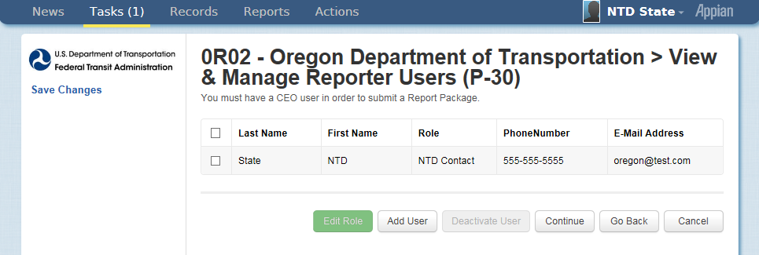
Verify DOT Information
Update Users
The CEO/NTD Contact can change user roles
Only the UM can add new users
Individual users can edit their own profile

Slide 45
Identifying Subrecipients
Identify Subrecipients
Subrecipients from RY2014 are pre-loaded. Please verify this list
New subrecipients can be added from a list of existing agency profiles or created as needed.

Slide 46
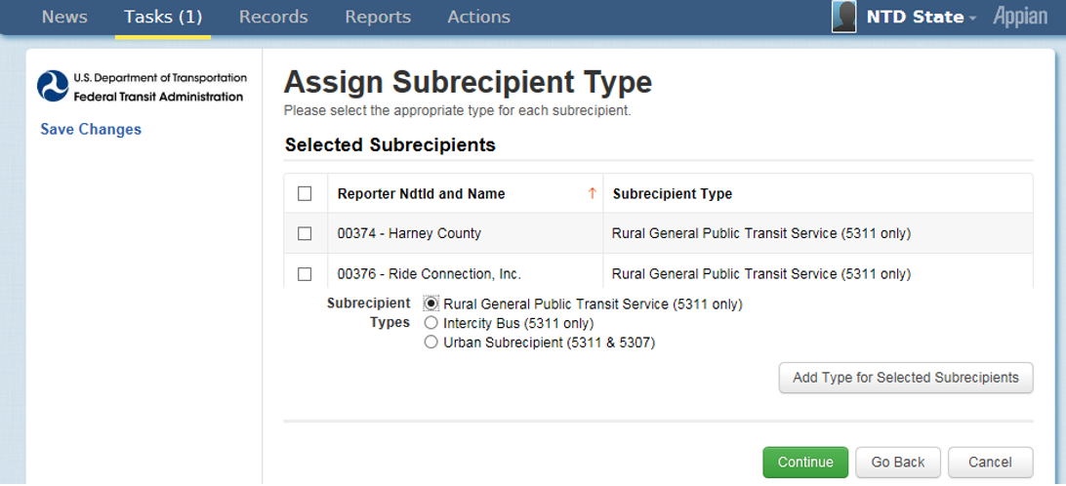
Assign Subrecipient Type
Assign Subrecipient Type
The type is pre-loaded from RY2014 CLO
To change, select the subrecipient by checking the box to its left, fill in the circle for type, and then click “Add Type”
Before changing subrecipient type from Rural General Public Transit service to another type, please consult your analyst.

Slide 47
Complete Report Year Kickoff
Form Generation
Profiles and Report Packages (Annual Forms) take at least three minutes to generate
Note: New subrecipients will require Analyst approval before generating
Click “OK” to end the task
The process is not complete until you see this message.

Slide 48
Defining subrecipient modes

Slide 49
How to Edit Subrecipient Modes
Click on “Records”

Slide 50
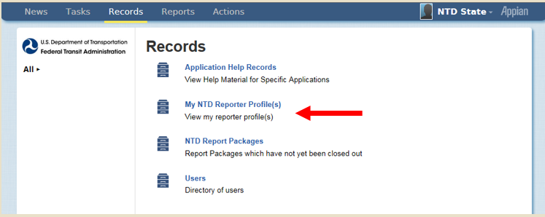
My NTD Reporter Profiles
Select “My NTD Reporter Profiles”

Slide 51
Select a Profile
Select a Profile
State users won’t see Profiles for Urban agencies

Slide 52
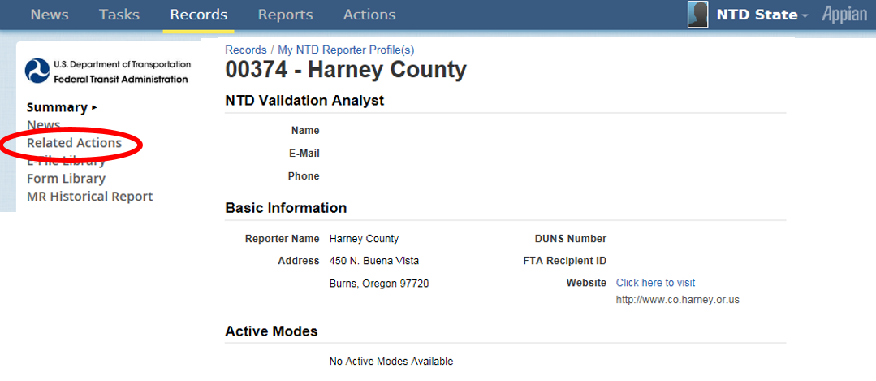
Select Related Actions
Select Related Actions
All forms have a non-editable “Summary” page
Data Entry & Edits require a “Related Action”

Slide 53
Select the P-20
Select the P-20 (View & Manage Reporter Modes)

Slide 54
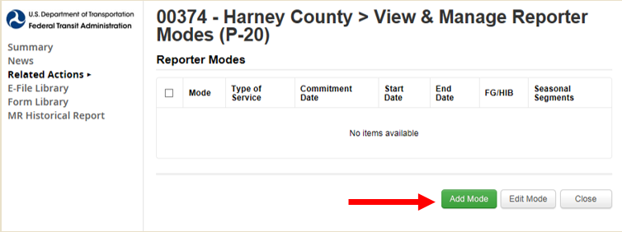
Click “Add Mode” Button
Click “Add Mode” Button
Once modes are entered into the new system, the data won’t need to be entered for future report years.

Slide 55
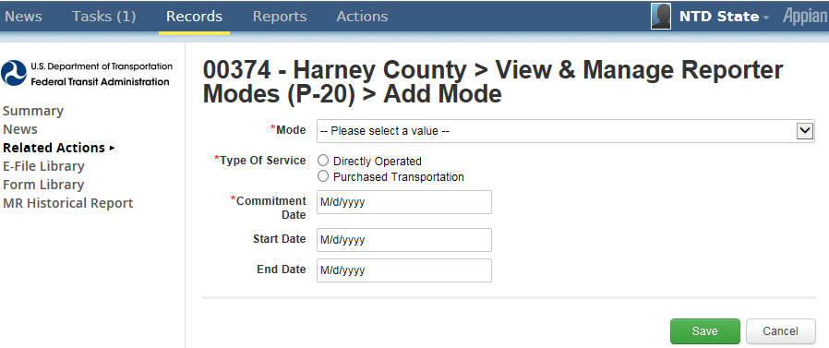
Defining Modes
Define the new mode and click “Save”
What is the mode? Bus (MB), Demand Response (DR), Vanpool (VP), etc.
Type of Service: DO (Directly Operated) or PT (Purchased Transportation)
Commitment Date: When capital funds were first expended
Start Date: First day of revenue service

Slide 56
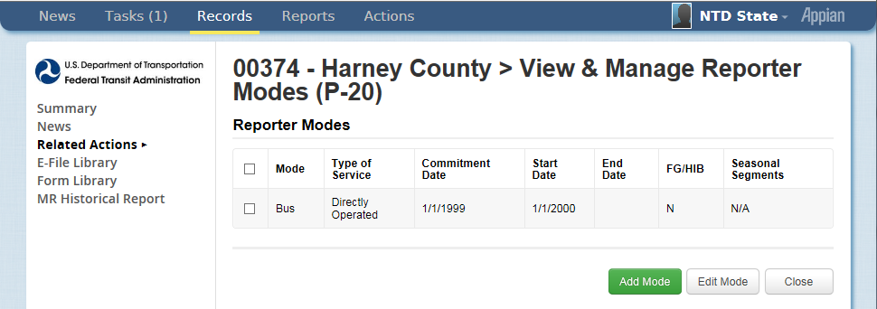
Edit Modes
Edit Modes
Repeat the process if the subrecipient has more than one mode
Select a mode and click “Edit Mode” to edit an existing mode

Slide 57
Rural General Public Transit (RGPT)
Annual Forms

Slide 58
Rural General Public Transit (RGPT)
Definition: Agencies that provide rural service and receive or benefit from 5311 funding. (Does not include those receiving §5307 funding or Tribes)
Required Forms:
B-10
Organization Type and Fiscal Year Start and End Dates
A-10 (Multiple Modes may populate Multiple Forms)
Maintenance Facilities
A-30 (Multiple Modes may populate Multiple Forms)
Revenue Vehicle Inventory
RR-20
Financial Data
Service Data
Safety Data
Volunteer Data

Slide 59
Updating Subrecipient Report Packages
Step 1: Open “Records”

Slide 60
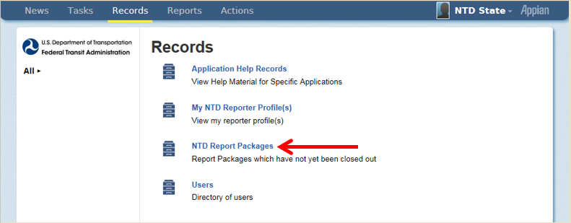
Open “NTD Report Packages”
Step 2: Open “NTD Report Packages”
These packages will contain the annual forms for all of your subrecipients

Slide 61
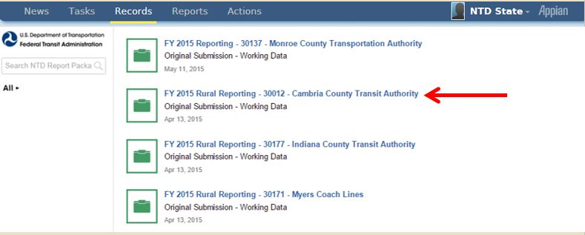
Package Selection
Step 3: Select the Package you want to edit

Slide 62
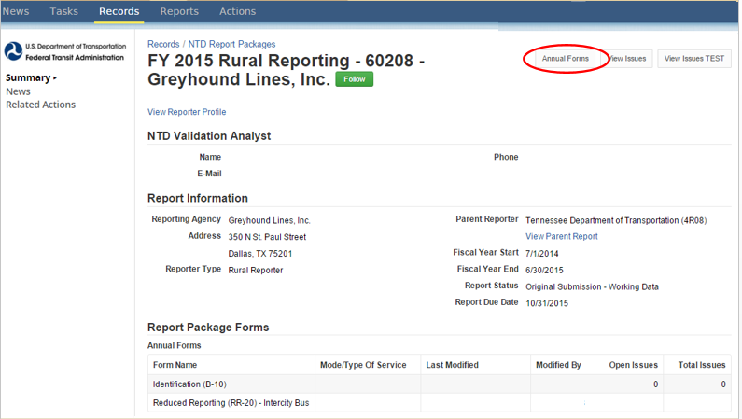
Select Annual Forms
Step 4: Select “Annual Forms”

Slide 63
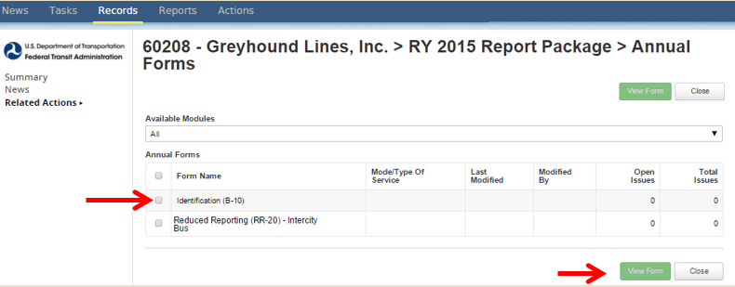
View Form
View Form
Step 5: Click on the Radio Button next to the form you would like to fill out and click on “View Form”
The form will then open up

Slide 64
B-10 Form
Basic Information

Slide 65
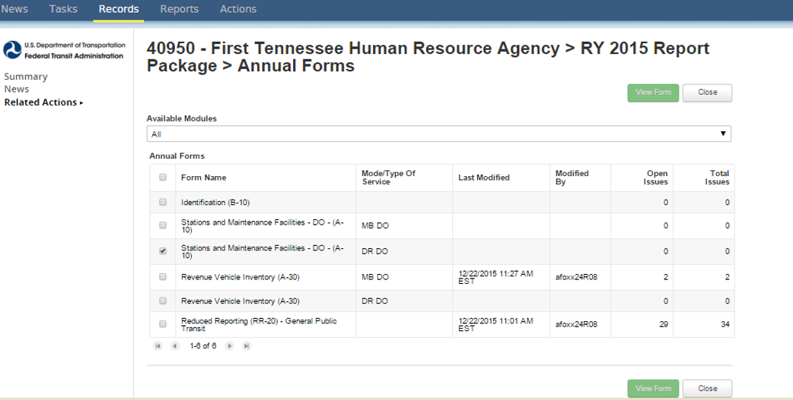
Open B-10 Form
Step 1: Open the B-10 form
Check the box
Click “View Form”

Slide 66
Update General Information
Step 2: Select “Update General Information”

Slide 67
General Information
Step 3: General Information
Organization types are in a drop-down menu
Fiscal Year State Date
Fiscal Year End Date

Slide 68
Save and Close
Step 3: “Save” and “Close”

Slide 69
A-10 form
Stations & Maintenance Facilities

Slide 70
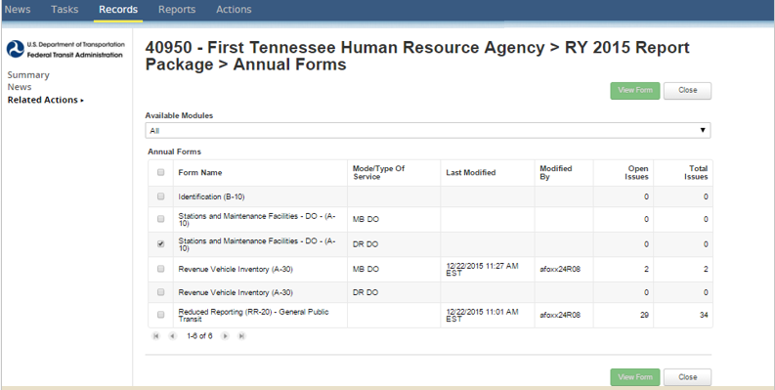
View Form
Step 1: Open the A-10 form
Check the box
Click “View Form”

Slide 71
Enter Data and Click Save
Step 2: Enter Data and Click “Save”
If facility is used by more than one mode, report a pro-rated share based on the amount of vehicles it services

Slide 72
A-30 form
Revenue Vehicle Inventory

Slide 73
Historical A-30 Data
Starting Report Year 2014, agencies were required to report individual modal data, including assets by mode.
For RY15, the A-30 data will be pre-filled with the RY14 Closeout version of the form.

Slide 74
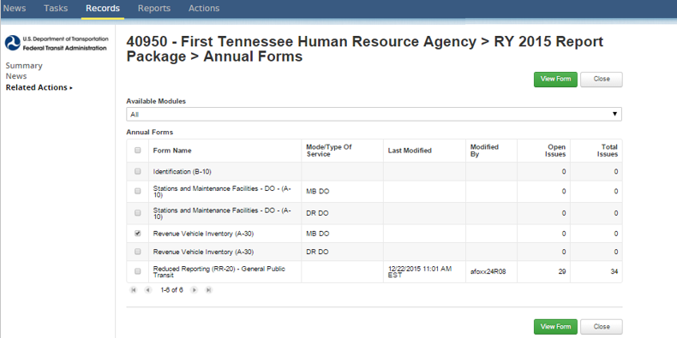
Open the A-30 Form
Step 1: Open the A-30 form
Check the box
Click “View Form”

Slide 75
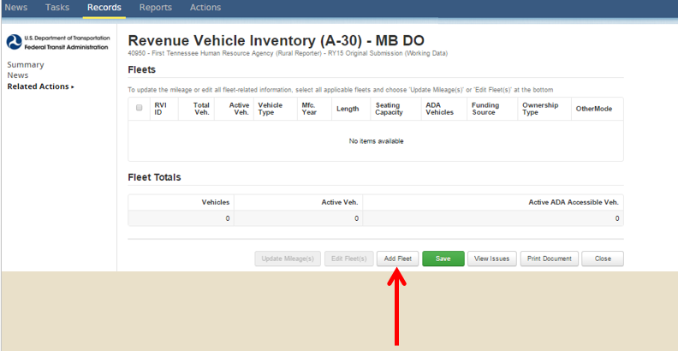
Add Fleet
Step 2: Click “Add Fleet”

Slide 76
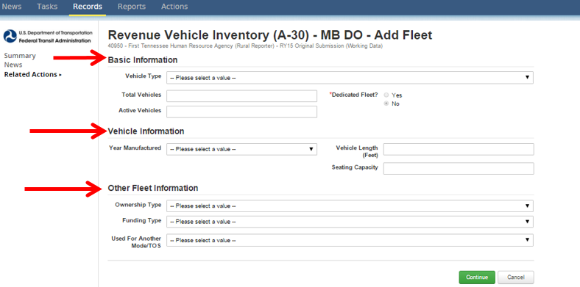
A-30 Required Information
Step 3: Fill out the form and click “Continue”.
If the Fleet is used by both modes, use the drop down menu to select the other mode.

Slide 77
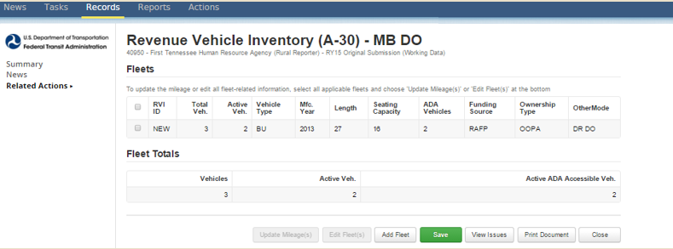
New RVI
Step 4: Click Save
Saving assigns a RVI ID
Click “Add Fleet” for more vehicles

Slide 78
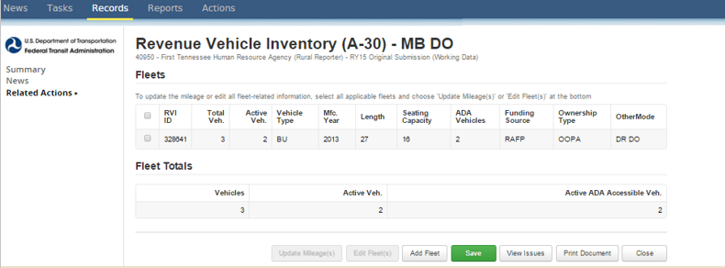
Saved new RVI
Step 5: Click “Close”

Slide 79
Common Validation Issues
Shared Fleets do not match across modes
If a fleet is shared between both modes, the fleet must be entered into all applicable A-30s, and all data fields must match
New Vehicles, no Capital Funding Reported
If new fleets are added to the report, the Capital Funding will be entered on that agencies RR-20
Missing Data
All fleet data must be filled out prior to submission

Slide 80
RR-20
Rural General Public Transit (RGPT)

Slide 81
Reduced Reporting (RR-20) – RGPT
Broken out as follows:
Financial Information
Non-Federal Funding Data
Federal Government Funds
Resource Data
Service Data
Safety Data

Slide 82
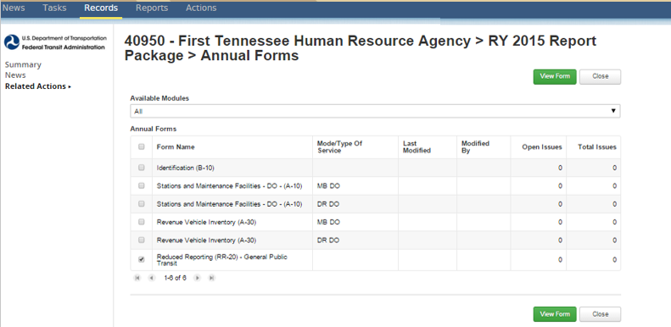
Open the RR-20
Step 1: Open the RR-20 form
Check the box
Click “View Form”

Slide 83
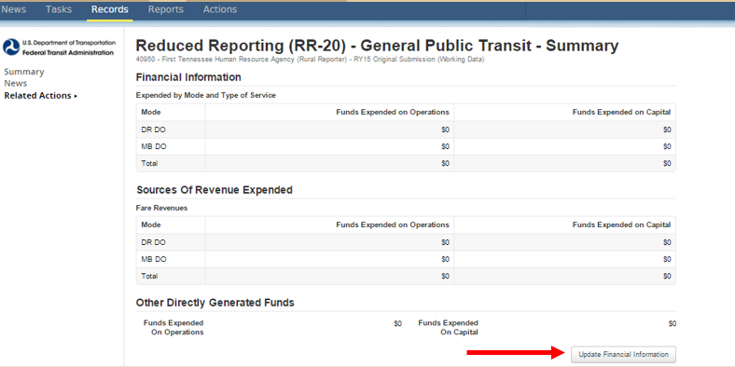
Update Financial Information
Step 2: Click “Update Financial Information”

Slide 84
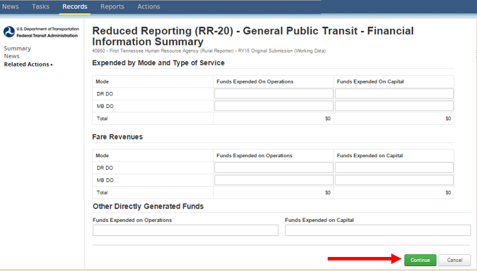
Data Entry
Step 3: Enter data and click “Continue” when finished.
Annual expenses by mode
Revenue applied from Fares
Other Directly Generated Funds

Slide 85
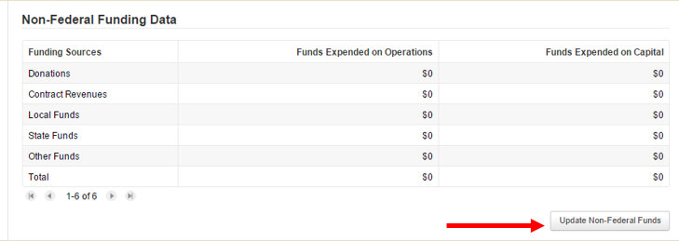
Update Non-Federal Funds
Step 4: Click “Update Non-Federal Funds”

Slide 86
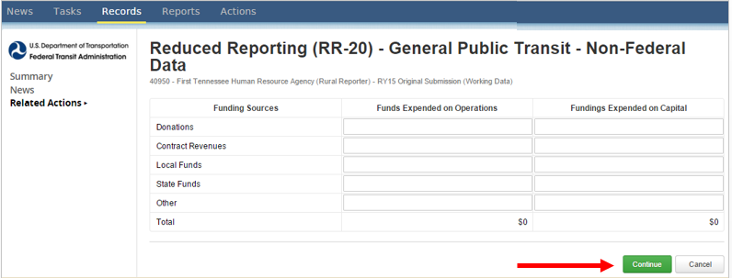
Enter Data
Step 5: Enter data and click “Continue” when finished

Slide 87
Update Federal Funds
Step 6: Update Federal Funds
Select the Federal sources that apply
Only those data input fields will show
Can change sources at any time

Slide 88
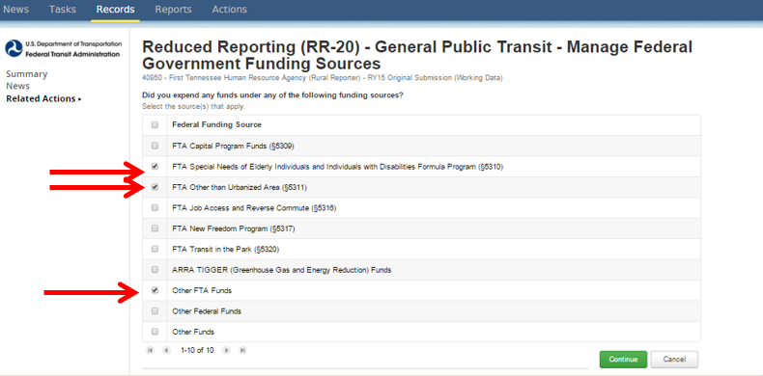
Update Federal Funding
Step 7: Select Federal Funding Sources and click “Continue”

Slide 89
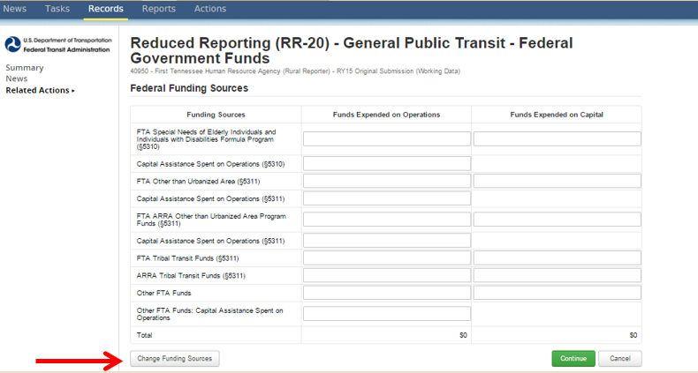
Change Funding Status
Step 8: Enter Data
Click “Change Funding Sources” to add more sources if needed

Slide 90
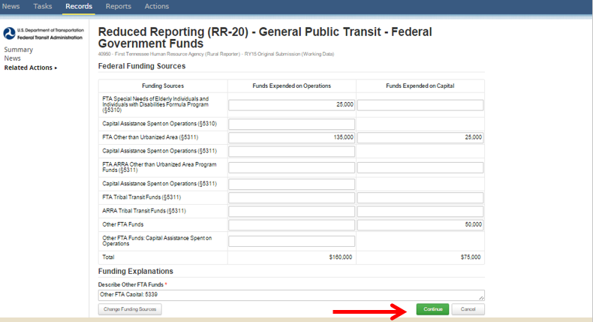
Click Continue
Step 9: Click “Continue”
“Other Federal Funds” and “Other FTA Funds” require a description

Slide 91
Update Other Resources
Step 10: Update Other Resources
This is a required section

Slide 92
Volunteer Data
Step 11: Enter Data and Click “Continue”
Enter zeros if no volunteers are used as this is a required section.

Slide 93
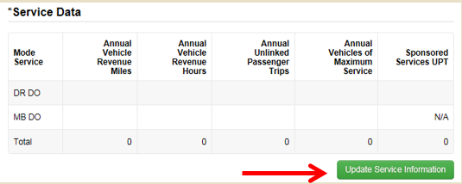
Update Service Information
Step 12: Update Service Information

Slide 94
Update Service Data
Step 13: Enter data, Click “Continue” when complete
Annual Unlinked Passenger Trips
For RY14 Annual UPT = Regular + Sponsored
Vehicles Operated in Maximum Service
Number of vehicles on road during peak service
Notes:
Vehicles operated in maximum service (VOMS) – Number of vehicles scheduled for the peak service on a typical day. It does not include:
Number of vehicles operated on atypical days such as holiday celebrations (e.g., Fourth of July), one-time special events (e.g., World Series celebrations, political conventions), or spare vehicles.
Vehicles in routine or extended maintenance, emergency contingency, and vehicles awaiting sale.
Source: www.ntdprogram.gov

Slide 95
Update Safety Information
Step 14: Update Safety Information
This is a required section

Slide 96
Click Continue
Step 15: Enter data and Click on “Continue” when complete
Incidents are: fatalities, injuries, or property damage >$25,000
Fatalities are deaths
Injuries are when passengers are transported away from the scene for medical attention

Slide 97
Click Save
Step 16: Click “Save”
This saves the ENTIRE form
“Save” after each “Update” to avoid loss of data

Slide 98
Common Validation Issues
Reporting more Sponsored Unlinked Passenger Trips than Total Unlinked Passenger Trips
Total Trips should be more than or equal to Sponsored Trips
Reporting only Federal Funds
Agencies should report total operating expenses to show the true cost of transit service

Slide 99
RR20 – Intercity bus

Slide 100
Intercity Bus Subrecipients
Definition: Regularly scheduled public service using an over-the-road bus that operates with limited stops between two urbanized areas or that connects rural areas to an urbanized area.
Required Information:
B-10
Fiscal Year Start and End Dates
Organization Type
RR-20 Intercity Bus Subrecipient
Section 5311 Funds
Vehicle Revenue Miles
Unlinked Passenger Trips

Slide 101
RR-20 - Urban/Tribal Subrecipient

Slide 102
Urban/Tribal Subrecipients
Definition: Transit agencies that commonly provide service to both Urban and Rural areas, may receive or benefit from §5307 funding.
Required Forms:
B-10
Fiscal Year Start and End Dates
Organization Type
RR-20- Urban/Tribal Subrecipients
Section 5311 Funds

Slide 103
Report Submission

Slide 104
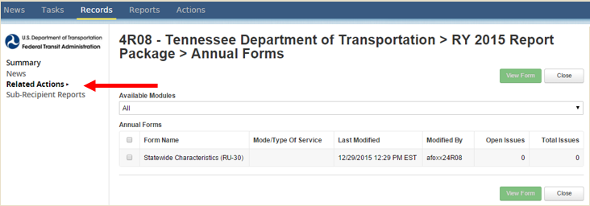
How to Submit
Step 1: Open the State Package and click on “Related Actions”
CEO and CEO Delegate can submit the Original Submission
NTD Contact is able to submit any revisions.

Slide 105
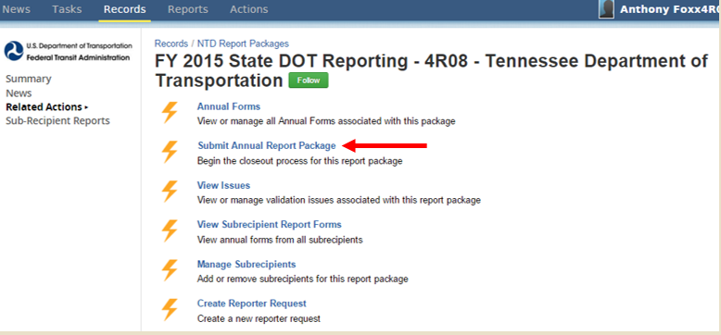
Submit Annual Report Package
Step 2: Click on “Submit Annual Report Package”

Slide 106
Confirm Package Submission
Step 3: If all data is filled out and no issues are firing, you will be able to Confirm Report Package Submission, and click “Continue”

Slide 107
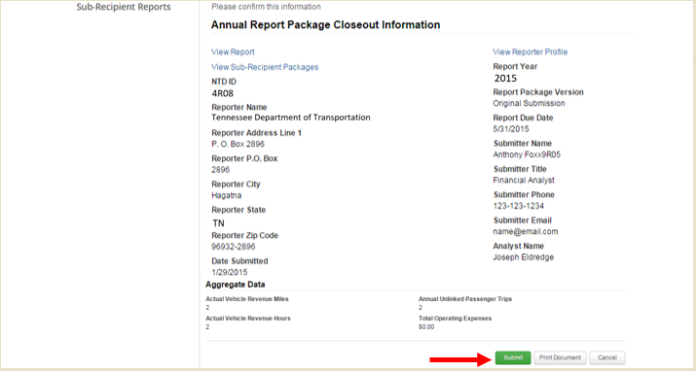
Aggregate Data Review
Step 4: Review the data presented
At the bottom of this page, it will have a snapshot of your aggregate data reported.
Click “Submit”

Slide 108
Action Completed
The top of the page will notate “Action Completed Successfully”
You may go to the State’s reporting package and verify that the package has been submitted, if the package’s status is “In Review” instead of “Working Data”

Slide 109
Validation Process
Analysts validate for deviation from reporting requirements, missing data and data irregularities
RY15 will follow the same validation process as RY14
Excel file for validation
Return Excel file and resubmit your report when you are done
Take advantage of resources
Pre-submission calls
Checklist
Notes:
This year’s validation process will work similarly to last year’s with the use of an Excel sheet containing a portion of your validation issues.
As with last year, please don’t forget to finish the submission of your report (under Related Actions) and email us your Excel sheet each time you complete a revision.
We’re here to help, we have large caseloads and see this stuff all the time!

Slide 110
Reviewing Reports
Data Entry and Revision
Data issues explained or corrected
NTD Review
Issues identified
Clean Closeout
All issues resolved
Closeout with Issues
Some issues not resolved, cited in closeout letter
Notes:
It is common for reporters to go back and forth with submission.
In rare cases, if a reporter is unresponsive to requests during the NTD review, a letter will be sent to the CEO.

Slide 111
Resolving Issues
Provide a solid and detailed explanation
Stating that a data point “is correct” is not an acceptable response to an issue
If you find that last year’s data is wrong:
Show what incorrect value should have been
Explain why this year’s data is correct

Slide 112
Agency Checklists
Resolve common reporting errors
Matching values
Newer requirements
Reduce validation time
Notes:
Complicated issues, namely with service forms and financial information, should be worked through with your analyst directly.
Retrieval of data, verification of accuracy, and compliance with NTD Reporting standards are the largest challenges when completing the NTD Report
A large number of reports are sent back to reporters because of typos or errors in oversight.
By using the checklist provided to review your report each time you submit, you can save time and reduce the number of revisions to your report

Slide 113
Questions and Comments
NTD Operations Center
Monday – Friday
8:00 a.m. – 7:00 p.m. (ET)
NTDHelp@dot.gov or 1-888-252-0936
Joseph Eldredge
joseph.eldredge.ctr@dot.gov
434-993-8690
Melissa Lavey
melissa.lavey.ctr@dot.gov
434-207-8336
Bailey Bowen
bailey.bowen.ctr@dot.gov
434-218-3275
Courtney Springer
c.springer.ctr@dot.gov
434-260-6116

