Slide 1
National Transit Database
NTD 2.0 Reporting for Tribes
Report Year 2015

Slide 2
Contact Information
National Transit Database
943 Glenwood Station Lane, Suite 102
Charlottesville, VA 22901
Help Desk
(888) 252-0936
NTDHelp@dot.gov
Monday- Friday
0800 – 1900 Eastern

Slide 3
Presenters
Courtney Springer
c.springer.ctr@dot.gov
434-260-6116

Slide 4
Agenda
Introduction
Interface Overview
User Account Management
Report Year Kickoff
Annual Forms
Conclusion

Slide 5
What is the National Transit Database?
The NTD was established by Congress to be the Nation’s primary source for information and statistics on all public transportation modes of the United States.
Conditions and Performance Report
FTA’s biennial report on the nationwide capital investment needs for public transportation
Source of data for performance measurement benchmarking
Research

Slide 6
Who Reports (Rural Module)
All States, Tribes and Territories benefiting from the FTA §5311 Program allotment
Current subrecipients (sub-grantees) of those funds
Previous subrecipients of those funds who have not reached end of required reporting period
Future subrecipients of those funds (voluntary reporters)

Slide 7
When to Report
Reporting Deadlines
Fiscal Year End Date | January 1 – June 30 | July 1 – September 30 | October 1 – December 31
Report Due Date | October 31 | January 31 | April 30

Slide 8
How to Report
Accrual Accounting
Revenues are recorded when earned, regardless of whether or not the receipt of the revenue takes place in the same reporting period
Example: A passenger purchases $10 worth of fare, but only uses $5

Slide 9
How to Report
Accrual Accounting
Expenditures are recorded as soon as they result in liabilities for benefits received, regardless of whether or not payment of the expenditure is made in the same reporting period.
Example: An employee receives a paycheck 10 days after it was issued. The receipt date is in a new fiscal year.

Slide 10
FTA News
Fixing America’s Surface Transportation Act (“FAST Act”) passed
Signed December 4, 2015
Five-year authorization bill
Increased funding for Tribal Transit to $35 million
$30 million formula
$5 million discretionary

Slide 11
FTA News
Tribal Transit Awards
Announced December 14, 2015
Awarded approximately $10 million in discretionary grants
Provided funding to 55 tribes for 65 transit-related projects in 18 states

Slide 12
Policy Changes - 2015
Tribes may report operating data for Coordinated Human Service programs, provided the services meet NTD definitions of public transportation

Slide 13
Admin Changes – 2015
New User Role: CEO Delegate
CEO Delegates are authorized to
Submit Original Submission of NTD Reports
Create Reporter Requests on behalf of the agency (extension requests, data waivers, etc.)

Slide 14
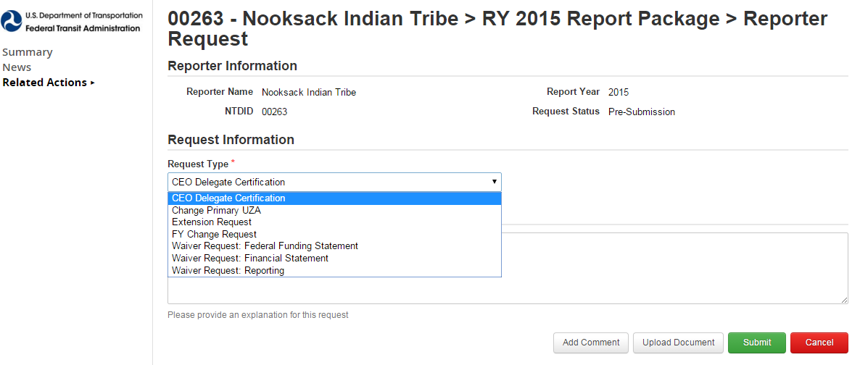
Admin Changes - 2015
The CEO may assign this role by submitting a reporter request and uploading a CEO delegate designation letter

Slide 15
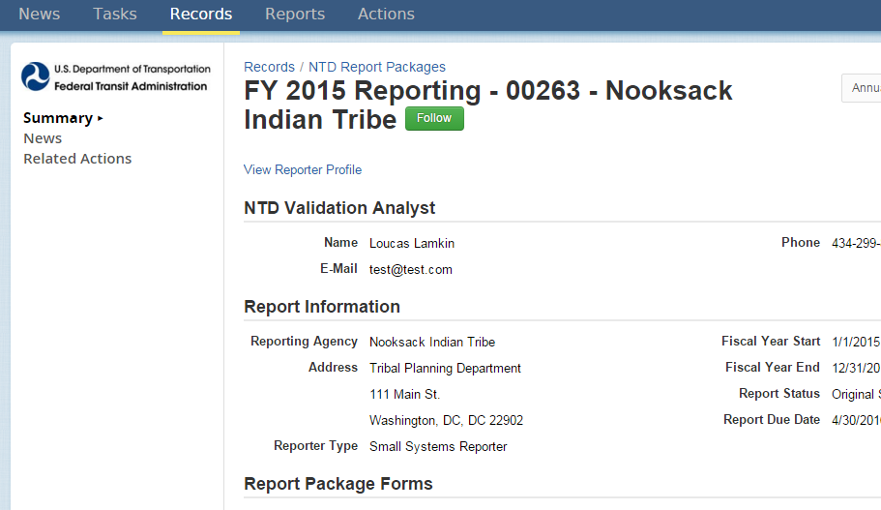
System Structure Changes - 2015
Users may now navigate directly to Profile from Report Package

Slide 16
NTD 2.0 Interface Overview
Internet Reporting

Slide 17
NTD Reporting
New NTD website: https://www.fta.dot.gov/ntd

Slide 18
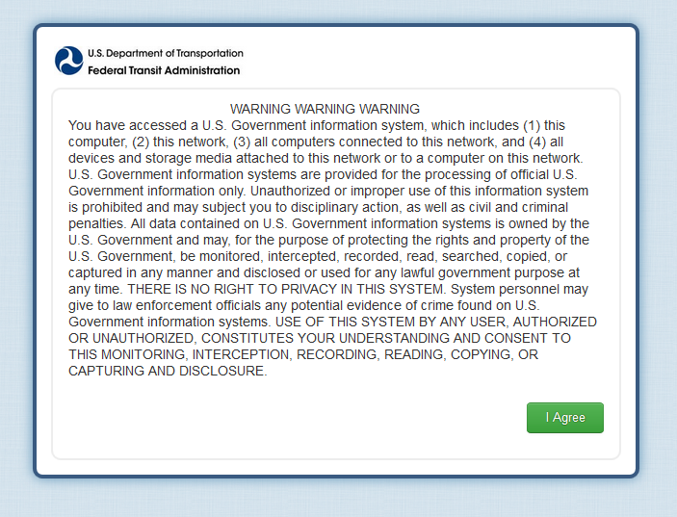
Privacy Disclaimer

Slide 19
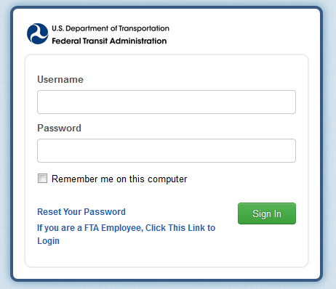
Logging In
Username = email address (lowercase letters)
If you forget your password, hit the “Reset Your Password” link

Slide 20
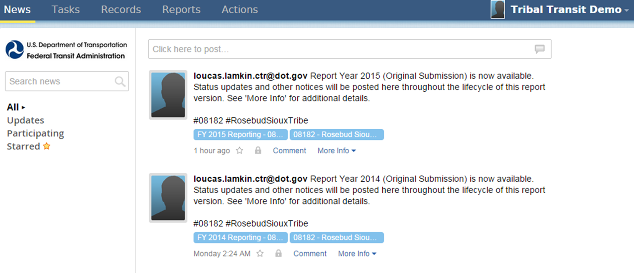
Interface Overview
All users land on the News feed
Updates from NTD staff will display here

Slide 21
Tasks
Tasks are assigned to CEOs, CEO delegates, and NTD Contacts
Typically prompted by incomplete/unsaved forms

Slide 22
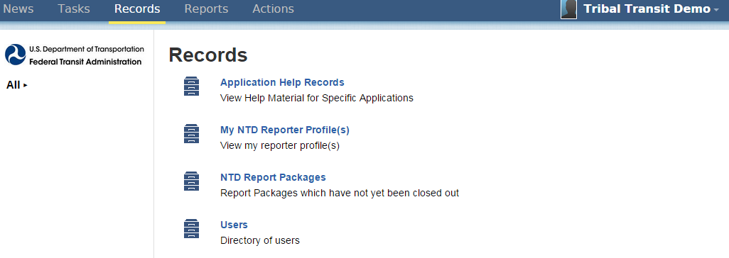
Records
Agency reporting forms and profile information are accessed through “Records”

Slide 23
Reporter Profiles
These forms contain data that normally doesn’t change from year to year:
Basic Information (P-10)
Reporter Modes (P-20)
Report Users (P-30)

Slide 24
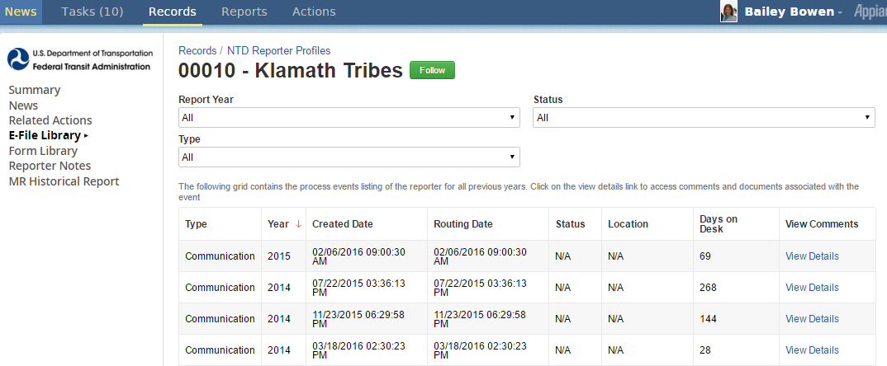
Reporter Profiles
E-File Library
Filter through communications

Slide 25
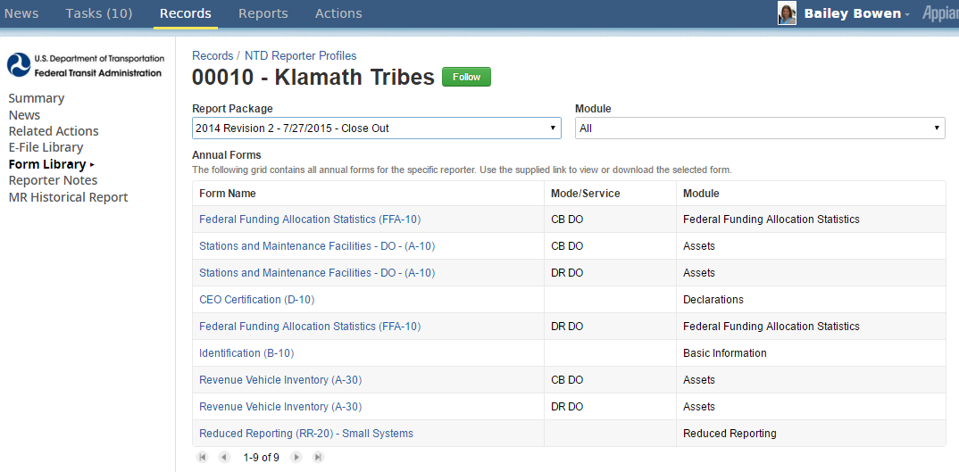
Reporter Profiles
Form Library
Search for data from previous years or revisions

Slide 26
Reports
Report packages may also be accessed through “Reports”

Slide 27
Report Packages
A “Report Package” contains all the forms required for annual reporting
Identification (B-10)
Contractual Relationship (B-30) *if applicable
Stations & Maintenance Facilities (A-10)
Revenue Vehicle Inventory (A-30)
Reduced Reporting (RR-20)
Federal Funding Allocation Statistics (FFA-10)
CEO-Transit Director Certification (D-10)

Slide 28
User Account Management
Getting Started

Slide 29
User Manager (UM)
Every agency must send FTA an official letter designating an employee as the agency’s User Manager.
The UM creates accounts for the CEO/Director and the NTD Contact. The UM can create accounts for others to enter/edit information or just view forms.
The UM can also fill an NTD Role. For example, the CEO can also be the agency’s UM.
Notes:
FFA-20

Slide 30
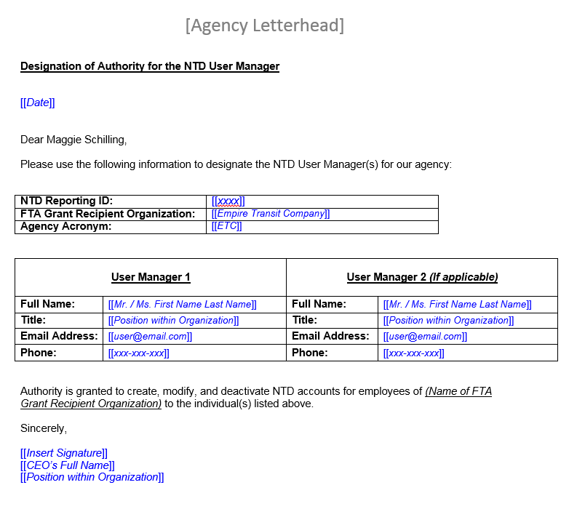
User Manager Request Letter
Agencies submit an official letter to FTA designating one or two User Managers using this template
Available on the NTD homepage

Slide 31
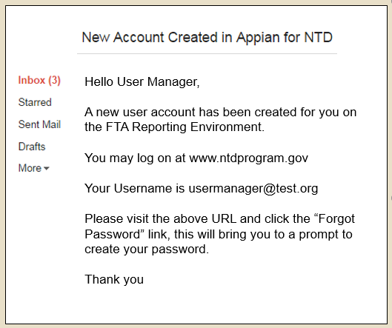
Email to UM
User Managers will receive an email notification once their account has been created
Click the link in the email to navigate to the online reporting interface
Notes:
Registered User Managers receive email

Slide 32
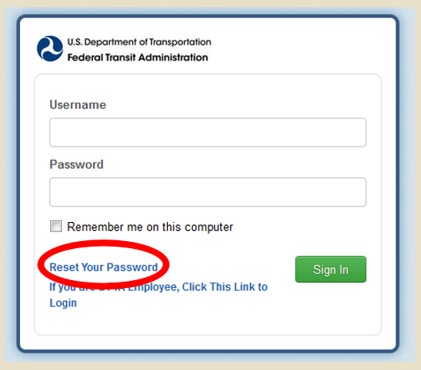
Reset Password
Passwords are NOT sent via email
Once at the login page, click the link for “Reset Password”
These steps are necessary for creating your first password

Slide 33
Request a Reset
Enter the email address used for your username and click “Request Password Reset”
This prompts the system to send a new link to your email account

Slide 34
Temporary Link for Password Reset
Follow the new link in your email
This link expires after 15 minutes
If 15 minutes have passed, follow the password reset procedure again

Slide 35
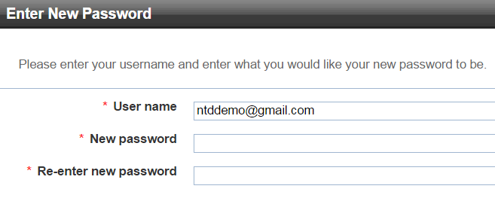
Create a password
Enter your username and create a new password
Must be at least 12 characters long
Must contain at least 1 uppercase letter, 1 lowercase letter, 1 number, and 1 non-alphabetic character (such as !, $, #, %)

Slide 36
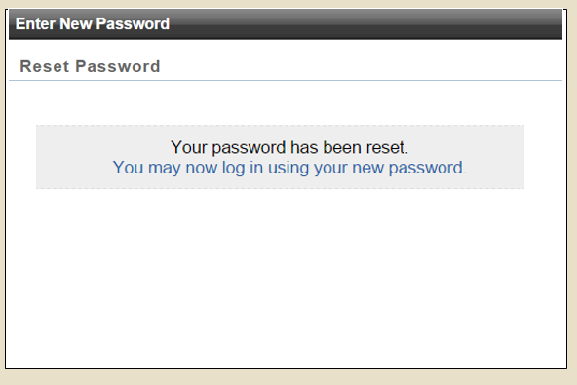
Confirmation
You may then log in with your new password
The blue text will reroute you to the login portal

Slide 37
Creating User Accounts
Once the User Manager account is established, he or she has privileges to create other user accounts for the agency
The User Manager also assigns NTD system roles to each new user

Slide 38
User Roles
All users in the NTD system must be assigned a specific role
These roles determine a user’s permissions
CEO (one per agency)
CEO Delegate (one per agency)
NTD Contact (one per agency)
Editor (agency may have multiple)
Viewer (agency may have multiple)

Slide 39
Permissions by User Role
CEO:
Create, review, and edit all forms and issues
Create a Reporter Request (Waiver, Extension Request, CEO Delegate)
Submit Annual Report Package
CEO Delegate (optional):
Create, review, and edit all forms and issues
Create a Reporter Request (Waiver, Extension Request)
Submit Annual Report Package
NTD Contact:
View and edit all forms and issues
Submit Annual Report Package after first submission
Editor:
View and edit all forms and issues
Viewer:
View all forms and issues
Notes:
Change in name was a result of standardizing the Small Systems Waiver and Rural General Public Transit Service Forms

Slide 40
Title Slide
Step 1: Open the “Records” Tab

Slide 41
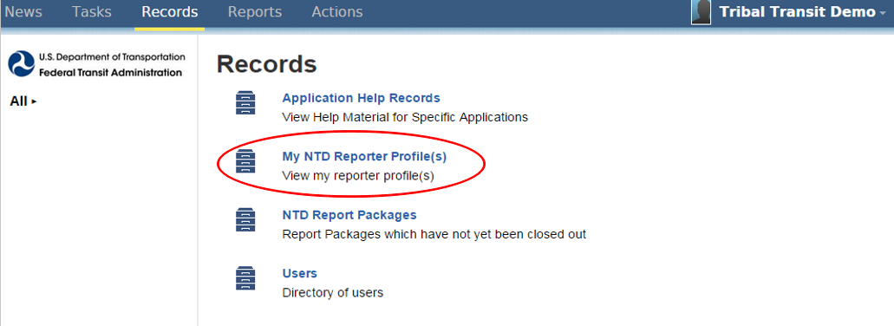
My NTD Reporter
Role
Title Slide
Step 2: Open “My NTD Reporter Profiles”

Slide 42
Open your Agency’s Profile
Step 3: Open your agency’s Profile

Slide 43
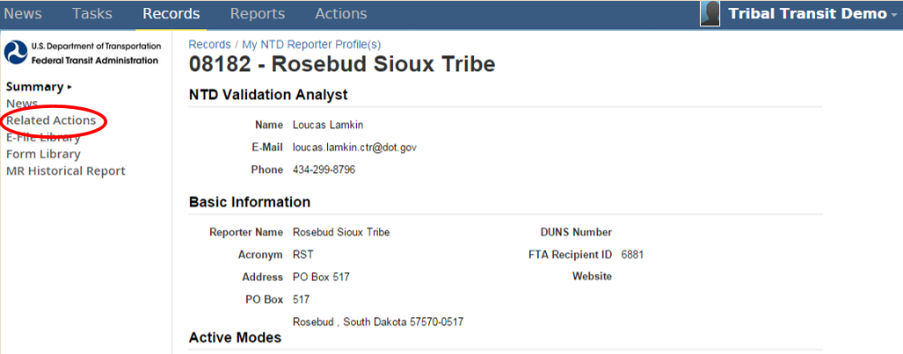
Click Related Actions
Step 4: Click “Related Actions”

Slide 44
View and Manager Reporter Users
Step 5: Open “View & Manage Reporter Users (P-30)”

Slide 45
Click Add Users
Step 6: Click “Add User”
Note: The User Manager’s account is defaulted to the “Viewer” role upon creation
If the UM would like to be the CEO, CEO delegate, or NTD Contact, click “Edit Role” and select accordingly

Slide 46
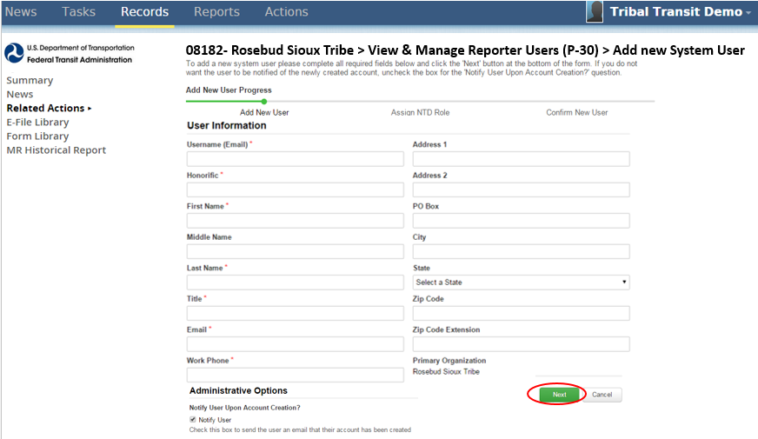
Enter new user data
Step 7: Enter new user data
- Fields with a red asterisk are required fields

Slide 47
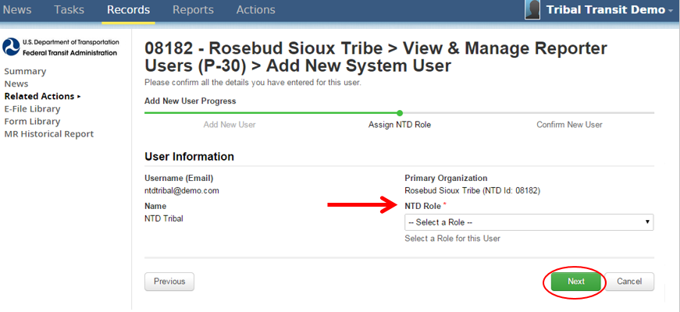
Assign NTD Role
Step 8: Assign NTD Role

Slide 48
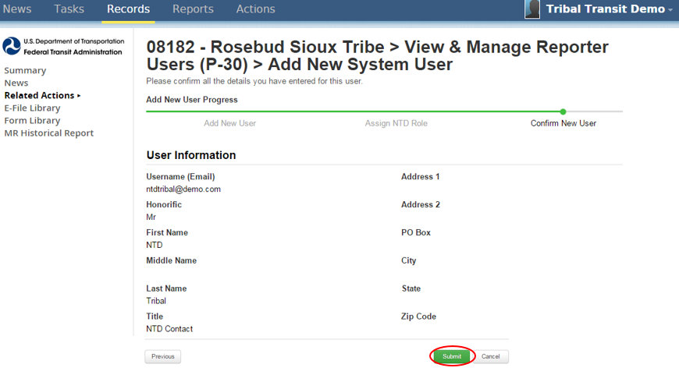
Click Submit
Step 9: Click “Submit”

Slide 49
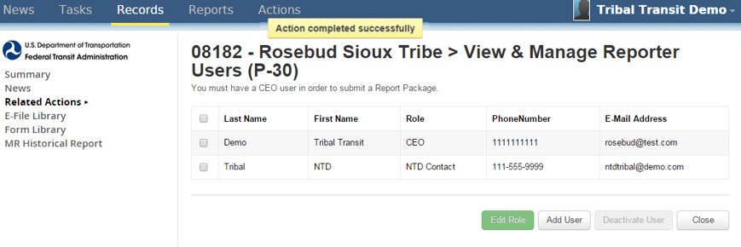
RYKO Steps
Newly created users will receive a link in their email
Will need to follow the “Reset Password” protocol
Repeat the process for all remaining users

Slide 50
ANNUAL REPORT YEAR KICKOFF
2015 Annual Report

Slide 51
Report Year Kick Off
This process sets up your report package for the year.
Completing the Kickoff process will allow you to:
Update user roles from year to year
Add or edit modes
Confirm reporter type for current report year (2015)
Confirm reporter type for next report year (2016)

Slide 52
Log in and click on Tasks
Step 1: Log in with CEO or NTD Contact Account
Step 2: Click on Tasks

Slide 53
Accept the Task and click proceed
Step 3: “Accept” the task, then click “Proceed”

Slide 54
Update Users
Step 4: Update Users
The CEO, CEO Delegate, and NTD Contact can update user roles
Only the UM can add new users

Slide 55
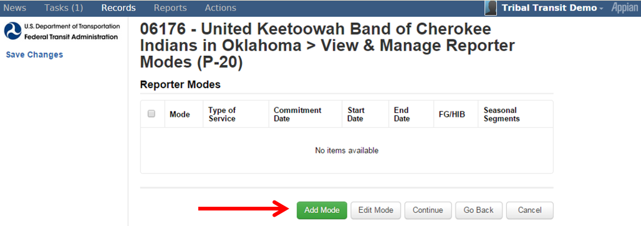
Add or Edit Modes
Step 5: Add or Edit Modes
For existing agencies, modes will pre-populate from the prior year
For new agencies, user will have to enter all modes manually

Slide 56
Add Mode
Commitment Date: When capital funds were first applied
Start Date: First day of Revenue Service
End Date: Last Day of Revenue Service (*leave blank if still operating)

Slide 57
Confirm Reporter Type
Step 6: Confirm Reporter Type for Current Report Year
As of 2015, all NTD Tribes are Small Systems reporters
Ensure that “No” is selected as you will not be changing reporter types

Slide 58
Confirm Reporter Type
Step 7: Confirm Reporter Type for Next Report Year
Ensure again that “No” is selected, then hit “Submit”

Slide 59
Form Generation
Step 8: Form Generation
After completing the Kickoff process, reporting forms may take up to three minutes to generate
Click “OK” to end the task

Slide 60
Completing the Annual Report
NTD Reporting
Completing the Annual Report

Slide 61
Reporting Forms
B-10 – Identification
B-30 – Contractual Relationship
A-10 – Stations and Maintenance Facilities
A-30 – Revenue Vehicle Inventory
RR-20 – Reduced Reporting Small Systems
FFA-10 – Federal Funding Allocation Statistics
D-10 – CEO Certification

Slide 62
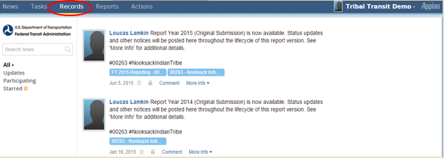
Open Records
Step 1: Open “Records”

Slide 63
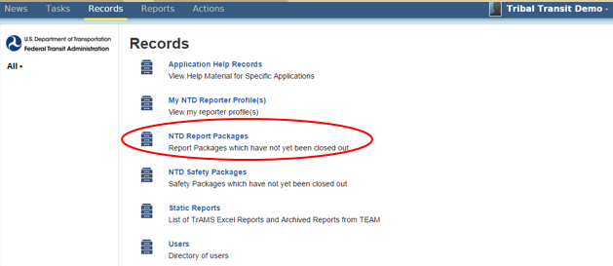
Open NTD Report Packages
Step 2: Open “NTD Report Packages”

Slide 64
Open FY15 Reporting
Step 3: Open FY 2015 Reporting
- Only the FY 2015 Package will be populated with forms

Slide 65
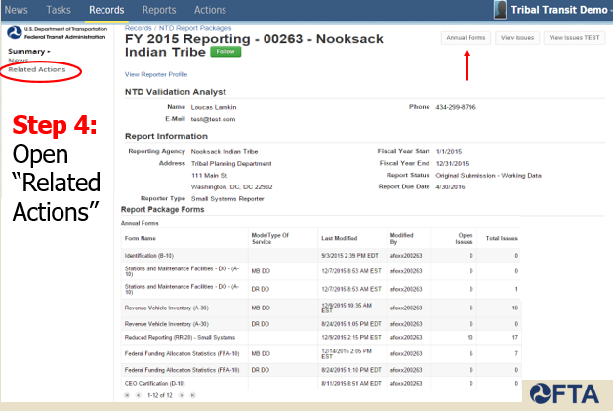
Open Related Actions

Slide 66
Open Annual Forms
Step 5: Open “Annual Forms”

Slide 67
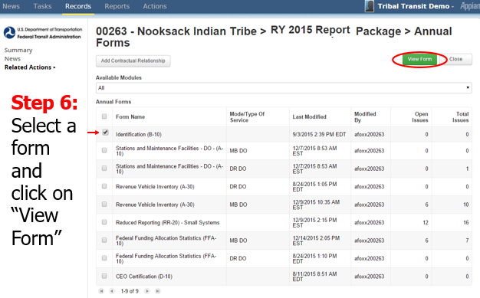
View Form

Slide 68
B-10 Basic Information
B-10: Basic Information
Identify organization type
Report basic demographic information

Slide 69
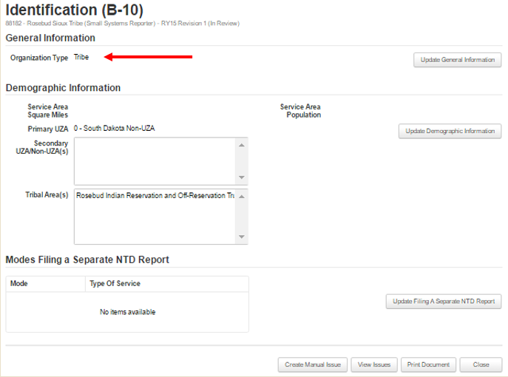
B-10 Basic Information
B-10: Basic Information
Update General Information (Organization Type = Tribe)

Slide 70
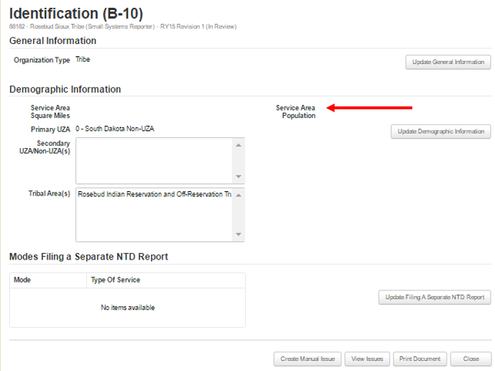
B-10: Basic Information
B-10: Basic Information
Update Demographic Information – Disregard the UZA/Non-UZA section unless instructed by analyst
Service Area Square Miles and Service Area Population are NOT required

Slide 71
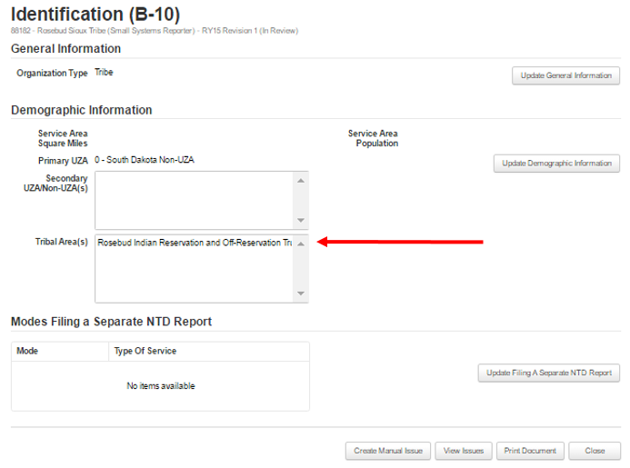
B-10: Basic Information
B-10: Basic Information
Tribal Area(s) – Update based on US Census Bureau data
You will report the areas you operate in according to NTD Serve Rules

Slide 72
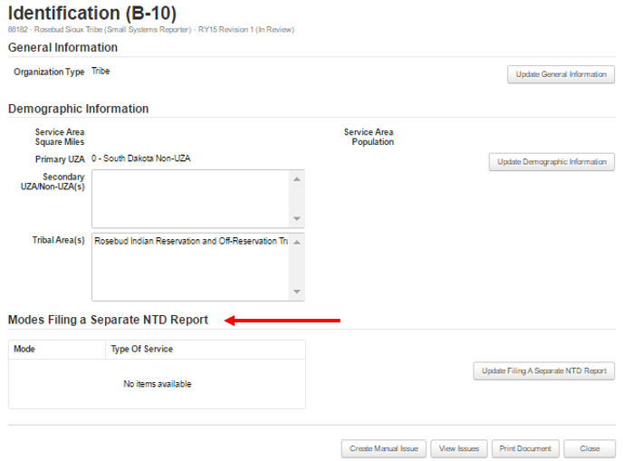
B-10: Basic Information
B-10: Basic Information
Do not update “Filing a Separate NTD Report” unless you subsidize a separate service.
Click on “Save” when finished

Slide 73
B-30 Contractual Relationship
Capture information for contracts with other agencies
Identify logistical specifics of the contract
Report basic financial information

Slide 74
B-30: Contractual Relationship
The NTD requires agencies that buy transit service to report this service as Purchased Transportation as long as it meets these three criteria:
Buyer must pay the full cost to provide the service
Service must operate in the name of the buyer
Seller must operate and manage the service

Slide 75
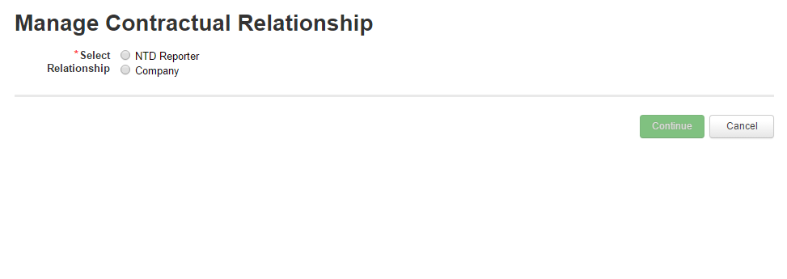
B-30: Contractual Relationship

Slide 76
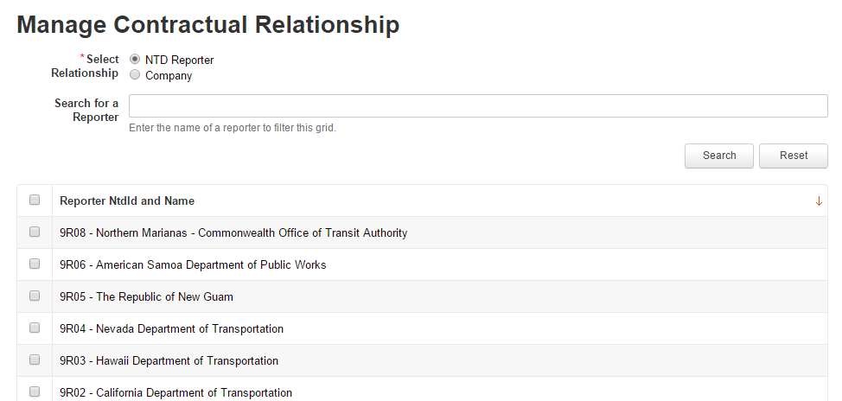
B-30: Contractual Relationship

Slide 77
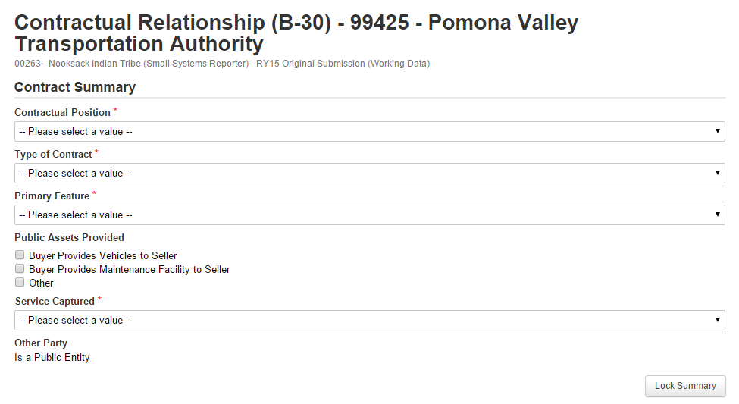
B-30: Contractual Relationship

Slide 78
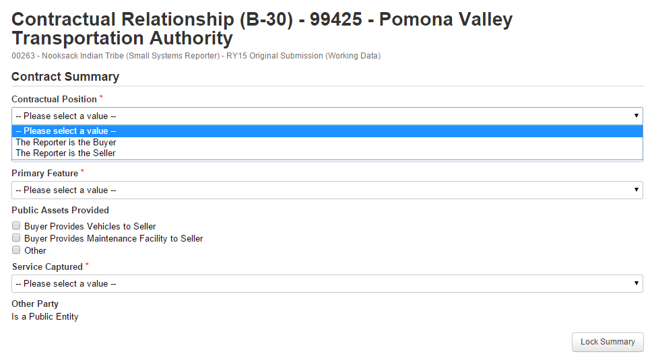
B-30: Contractual Relationship

Slide 79
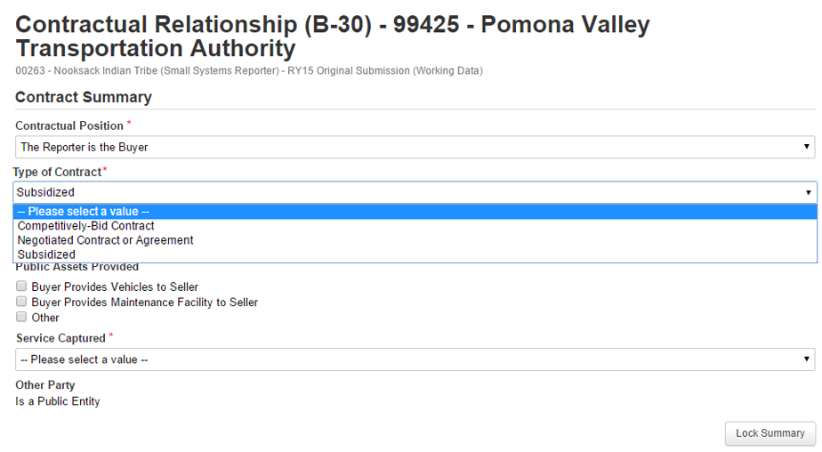
B-30: Contractual Relationship

Slide 80
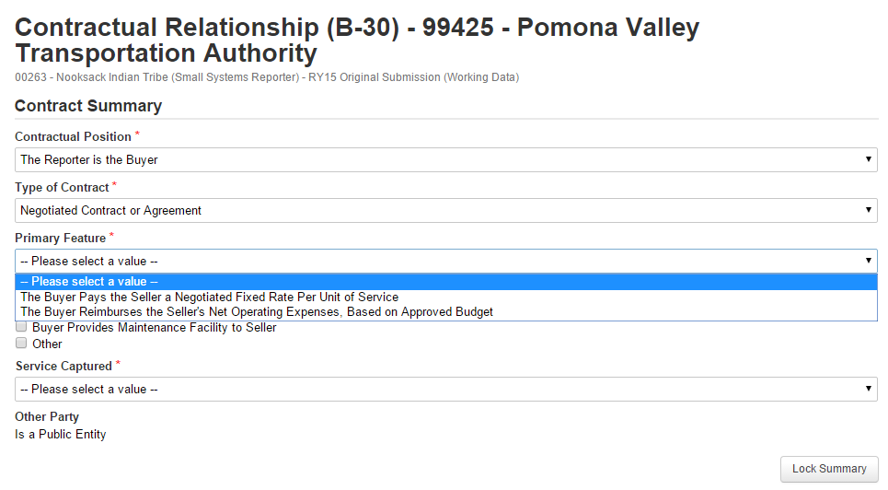
B-30: Contractual Relationship

Slide 81
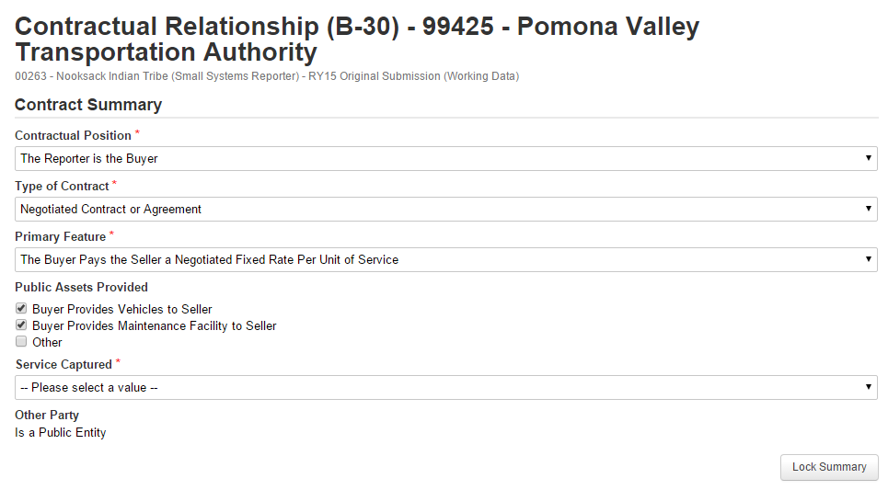
B-30: Contractual Relationship

Slide 82
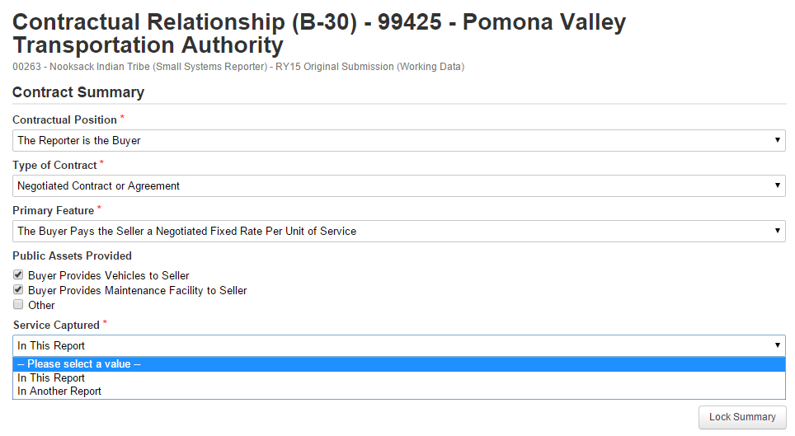
B-30: Contractual Relationship

Slide 83
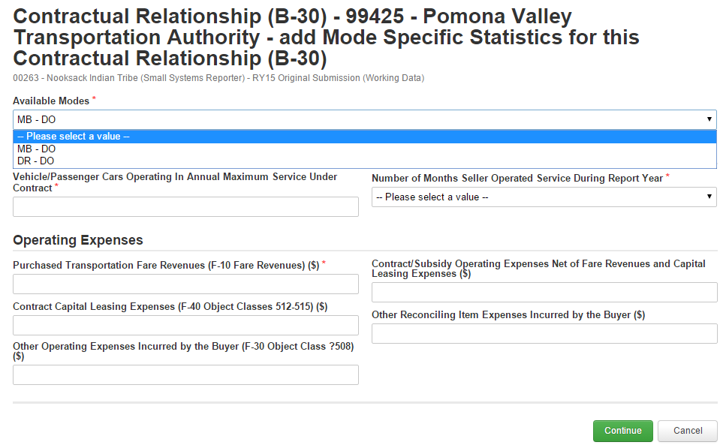
B-30: Contractual Relationship

Slide 84
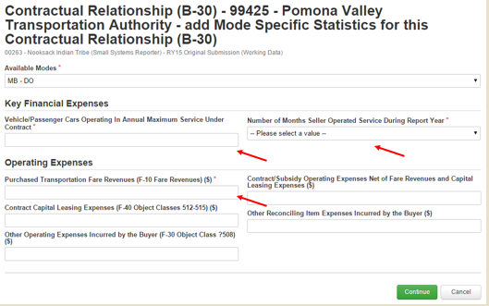
B-30: Contractual Relationship

Slide 85
B-30: Tribal Subsidy
Tribal Subsidies – Only applies if your agency contributes an annual subsidy to local transit service(s), rather than covering the full operational cost, and does not operate or purchase other modes

Slide 86
B-30: Tribal Subsidy
Example 1: A Tribe pays a local transit provider a fixed amount per year to operate a bus route extension. The provider adds several stops along one route to service the reservation. The buses are branded as, and managed by, the provider.
Solution: The Tribe is not covering the full cost of this service, and would report the financial contribution as a Tribal Subsidy.

Slide 87
B-30: Tribal Subsidy
Example 2: A Tribe contracts with a private company to operate demand response services. The Tribe covers the full cost of operations, brands the vehicles as Tribal Transit, and manages all scheduling and dispatching operations.
Solution: The Tribe would report this as a full-cost contract.

Slide 88
A-10: Stations & Maintenance Facilities
Report number of passenger stations
Report number of maintenance facilities
Indicate funding and ownership types

Slide 89
A-10: Stations & Maintenance Facilities
If a facility is used by more than one mode, report a pro-rated share

Slide 90
A-10: Stations and Maintenance Facilities
Reporting Tip: Allocation of Facilities
If a facility is used by more than one mode, allocation of that facility is based on the number of vehicles
For example, if one garage services both Motor Bus (MB) with 4 vehicles and Demand Response (DR) with 6 vehicles
The A-10 form for MB would have .4 of a facility
The A-10 form for DR would have .6 of a facility, totaling 1 facility.

Slide 91
A-30: RVI
A-30: Revenue Vehicle Inventory
Categorize vehicles in fleets
Identify basic vehicle information
Indicate vehicle funding and ownership types

Slide 92
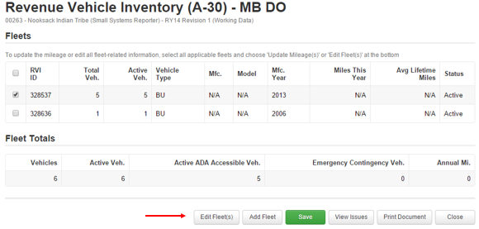
A-30: Revenue Vehicle Inventory
Fleet information is pre-populated from the 2014 Report Year.
Add new fleets or edit existing fleets

Slide 93
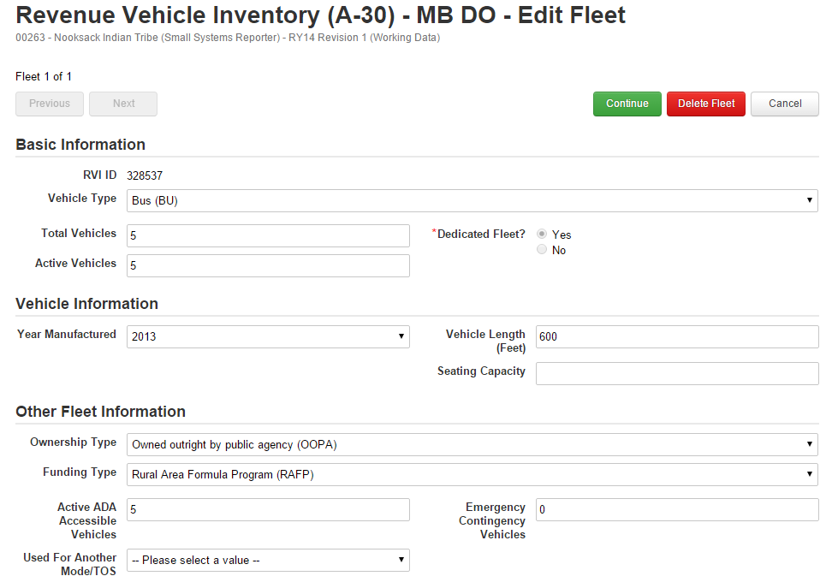
A-30: RVI
A-30: Revenue Vehicle Inventory
Enter fleet information

Slide 94
A-30: RVI
A-30: Revenue Vehicle Inventory
Reporting Tip: Retired Fleet Vehicles
Fleet vehicles can now be marked as Retired and will be removed from report in the next report year.
If certain fleets are no longer in use, retire them rather than deleting

Slide 95
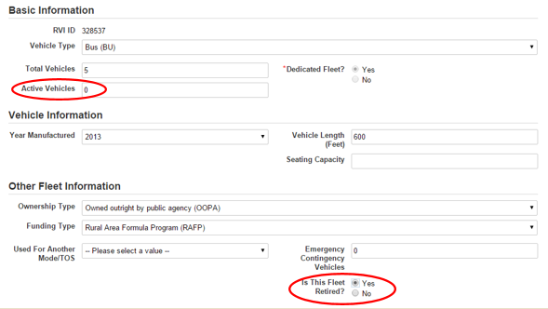
A-30: RVI
Update the number of Active Vehicles to 0 instead of deleting fleets
When Active Vehicles reaches 0, the system will give you an option to mark that fleet as retired

Slide 96
RR-20: Reduced Reporting
Financial Information
Non-Federal Funding Data
Federal Government Funds
Service Data
Safety Data

Slide 97
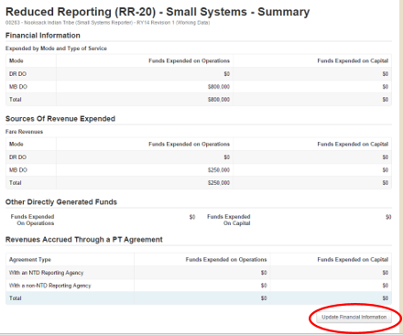
RR-20: Financial Information
Report expenses by mode
Report Fares as a source of revenue expended
Other Directly Generated Funds

Slide 98
RR-20 Cost Allocation Methods
Determine which expenses are direct expenses and can be easily traced to a particular mode/TOS.
Determine which expenses are joint expenses. These costs are incurred for the benefit of more than one mode/ TOS and cannot be easily traced to a specific mode/TOS.
Allocate joint expenses or shared costs to each mode/TOS.

Slide 99
RR-20 Cost Allocation Methods
Recognizing that some agencies may not allocate joint costs by mode/TOS, NTD suggests common allocation variables:
Revenue Hours
Revenue Miles
Number of Employees
Ridership
Notes:
While these options for allocating costs are common to the transit industry, in some instances others may be more appropriate.

Slide 100
Example – Allocating by VRM
Tribe operates a Dial-a-Ride or Demand Response (DR) service and a fixed-route bus (MB) service
Collects Annual Vehicle Revenue Miles (VRM) for each mode separately.
DR: 200,000 VRM
MB: 300,000 VRM
Does not allocate joint Operating Costs by mode.
Total Annual Operating Expenses: $100,000

Slide 101
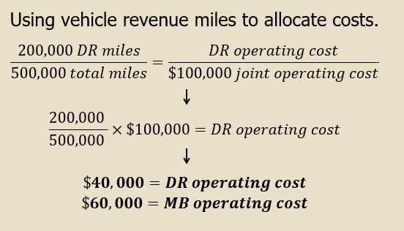
Example – Allocating by VRM

Slide 102
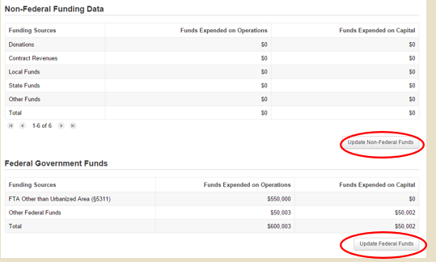
RR-20: Non-Federal and Federal Funds
Click on the “Update” buttons to enter data

Slide 103
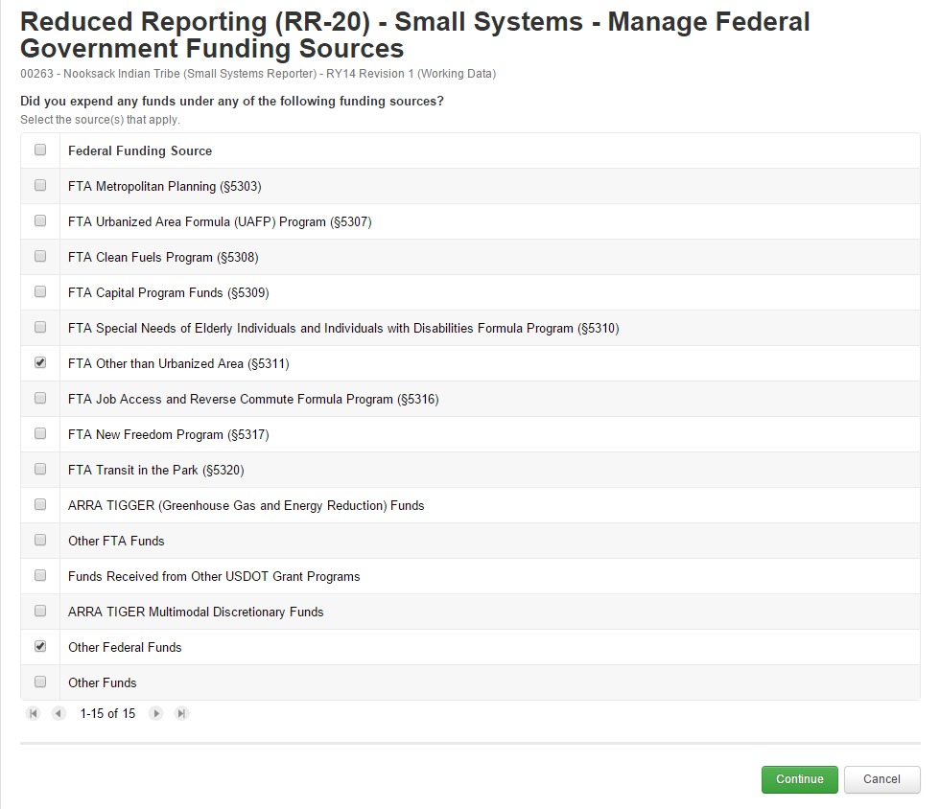
RR-20: Federal Funding Sources
Select federal funding sources

Slide 104
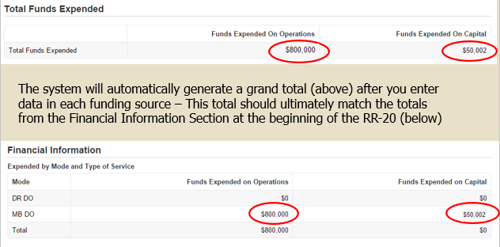
RR-20: Total Funds Expended

Slide 105
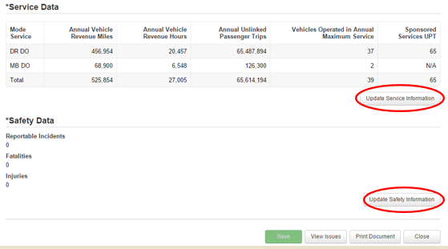
RR-20: Service and Safety Data

Slide 106
RR-20: Service Data
Vehicle Revenue Miles (VRM)
Annual mileage: does not include deadhead, fueling, maintenance work
Vehicle Revenue Hours (VRH)
Annual hours: does not include deadhead, fueling, maintenance work
Unlinked Passenger Trips (UPT)
Ridership: each passenger boarding = 1 UPT
I.E. Demand Response roundtrip=2 UPTs

Slide 107
RR-20: Service Data
Vehicles Operated in Annual Maximum Service (VOMS)
The number of revenue vehicles an agency operates to meet the annual maximum service requirement
Count VOMS based on the peak season of the year on the busiest day

Slide 108
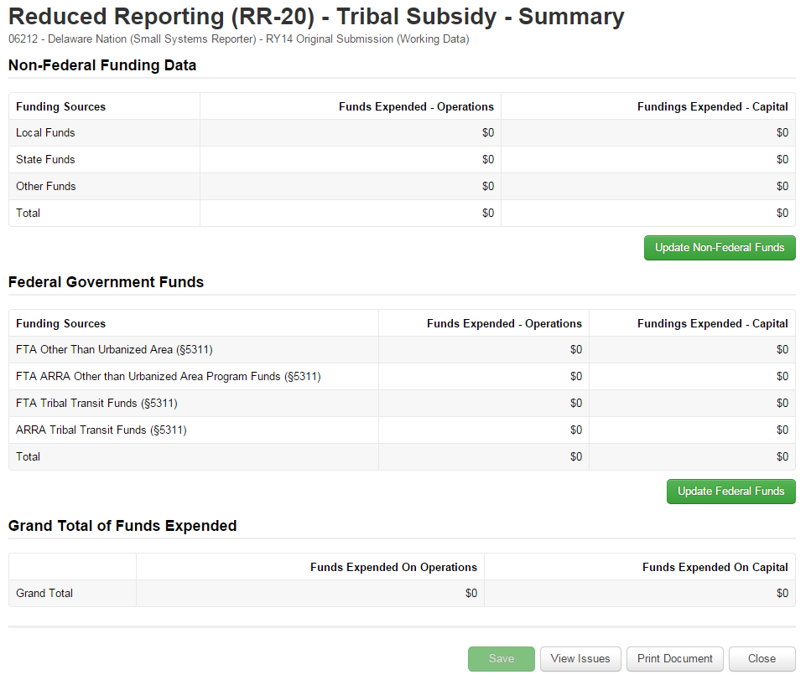
Tribal Subsidy – RR-20
Shortened version of NTD Report –
Fill in the Subsidy, NOT the full cost of service

Slide 109
FFA-10: Federal Funding Allocation
FFA-10: Federal Funding Allocation
Allocate vehicle revenue miles between multiple Rural Areas (non-UZA) or Urbanized Areas (UZA) as necessary.
Agencies that receive §5311 from two or more States report how much of its service is operated in each state.

Slide 110
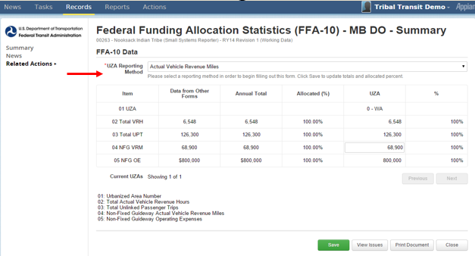
FFA-10 – Federal Funding Allocation Statistics
Select Reporting Method
One UZA/Non-UZA, select Actual Vehicle Revenue Miles
Multiple, select Actual VRM, Actual Data, or Other

Slide 111
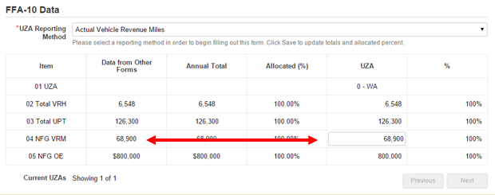
FFA-10: FORM
Enter data for the UZA
If only one UZA/Non-UZA – total should always match Data from Other Forms
If multiple, Allocated Percentage should always total 100% between all UZAs
With every change to the RR-20, update the FFA-10 forms accordingly

Slide 112
D-30: CEO Certification
D-10: CEO Certification
Confirmation that an agency’s data is accurate and truthful
Confirmation of UPT data collection methods

Slide 113
D-10 – CEO Certification
Select “Yes” if financial and non-financial data are accurate and conform to NTD/USOA requirements

Slide 114
D-10 – CEO Certification
Select the method your agency used to collect unlinked passenger trips

Slide 115
Report Submission
NTD Reporting
Report Submission

Slide 116
Submitting the Annual Report
Step 1: Click on Records
Step 2: Click on NTD Report Packages

Slide 117
Submitting the Annual Report
Step 3: Click on the FY 2015 Report Package

Slide 118
Submitting the Annual Report
Step 4: Click on Related Actions

Slide 119
Submitting the Annual Report
Step 5: Click on Submit Annual Report Package – If all forms are complete you will see “Action Completed Successfully”

Slide 120
Post-Submission
After submission, your NTD analyst will be in contact with validation results.
First revisions of NTD reports are typically due two weeks after receiving validation results.

Slide 121
Questions and Comments
NTD Operations Center
Monday – Friday
8:00 a.m. – 7:00 p.m (ET)
NTDHelp@dot.gov or 1-888-252-0936
Joseph Eldredge
joseph.eldredge.ctr@dot.gov
434-993-8690
Bailey Bowen
bailey.bowen.ctr@dot.gov
434-218-3275
Rea Turner
434-218-1917
Nathan Brown
nathan.brown.ctr@dot.gov
434-218-0415
Melissa Lavey
melissa.lavey.ctr@dot.gov
434-207-8336
Courtney Springer
c.springer.ctr@dot.gov
434-260-6116

